Slide 1
Fund III Performance Review | Q1 2025
April 2025

Slide 2
Executive Summary
Asset Management Operational Review
Financial Overview
Valuations
Fund Forecast

Slide 3
Executive Summary | Key Areas to Monitor
Focus Area
Sources & Uses | As of today, the fund has enough resources to fund all the deals in the pipeline other than Maple Tree. In anticipation of Maple Tree Closing, we are proposing a potential additional capital call for $274M for late May/early June, with funding mid June. Proceeds will be used for the acquisition of Maple Tree, which is scheduled to close late June. This capital call will bring us to 95% of all commitments, maintaining a 5% fund reserve. Since the Refi is expected to be closed in early July, we are expecting to receive temporary additional commitment on the Credit Facility from KeyBank for $100M.
Durability of Cashflows & Distributions | There will be no distributions for the remainder of 2025 We will reassess beginning distributions in 2026 once cashflows stabilize after the pipeline is acquired
Financing | The Fund is out to market for a refi on a pool of 47 properties expected to generate $340-370M of proceeds Initial bids have been received, with significant interest from the bank balance sheet, LifeCo, and CMBS (SASB) markets We will aim to take a decision on a lender and sign a term sheet within the next 2 weeks after evaluating and negotiating top bids

Slide 4
Executive Summary | Asset Management Operational Review
Leasing Spreads:
15 leases were signed in Q1 across 8 different markets, achieving 67% leasing spread over prior leases
Since inception, the Fund has signed 82 leases with 42% spread over prior leases
Escalations:
Escalations in Fund III are consistently just above underwriting
Q1 escalations were 3.49% against BP of 3.06%, while leases signed in last 12 months achieved 3.58% escalations vs 3.29% BP
Renewal Rate:
Renewal Rate for Fund III is trending at ~57% for the past 4 quarters
This rate trended slightly down this quarter, with 42% renewal rate in Q1 compared to 57% in last 12 months and 61% ITD
Downtime:
The Fund currently has 22 vacant spaces, 8 of which have extended downtime over 10 months
Vacant spaces are driven by a variety of factors including slow leasing activity, delinquencies, delayed timelines due to construction, and/or failed dispositions
Economic Occupancy:
Forecast Manager projects 88.6% economic occupancy for the Fund in 2025

Slide 5
Executive Summary | Financial Overview
Transaction Activity:
In Q1-25, the fund acquired 10 properties for a total cost of approximately $87M.
Additionally, in Q1-25 the fund sold 1 property (631 S. Royal Lane, Coppell, TX) for $9M, resulting in a $0.3M loss after closing costs
NOI & YOC:
NOI at $16.2M for Q1 increased from $15.1M in Q4, mainly due to new acquisitions.
Yield on Cost is 5.52% with Development and 5.68% (excluding Development) for Q1, representing an increase of 10bps from prior quarter mainly due to increases in Same Store NOI and acquisitions at higher YOC.
Same Store NOI (of ~$1,013M Total Cost of properties) also increased in Q1 from $13.7M to $14.3M, mainly due to recovery of previously written off bad debt.
FFO:
The Fund’s FFO is 1.0% for Q1, while Core FFO is 1.9% (adjusting for commitment fees). Theoretical Core FFO is 2.4% assuming 60% LTC and G&A of 0.5%.
Core AFFO was (2.0%) for Q1 after subtracting out $5.8M of capex and adding back $0.6M of financing costs amortization.

Slide 6
Executive Summary | Financial Overview
Financing & Leverage:
Cash basis effective interest rate was 5.81% excluding the subline and 5.92% including the subline
The economical effective interest rate in Q4 was 6.59% excluding the subline and 6.58% including the subline. This factors in the impact of unused fees, cap amortization, and financing costs amortization
The outstanding debt as of the end of Q4 was $663M, spread across $248M credit facility, $150M subline, $94.5M Apollo, $90M NYL, and $81.5M BX.
The overall weighted avg. LTC for Q1-25 (including the subline) stands at 58%. Excluding the subline, the weighted average LTC was 46%
There are 6 properties (not including development deals) outside of the pool due to vacancies, totaling $38M Total Cost.
The Fund is working on a CMBS refi for a pool of 47 properties expected to generate $340M-$370M in loan proceeds.
Sources & Uses:
As of the end of Q1 2025, the fund has acquired $1,197M Total Cost (including land) and spent $35M on CapEx for operating and development properties & $32M on other uses
The $32M other uses include, but are not limited to, origination fees, hedging costs, and financing the surplus of expenses over revenue (i.e., J-Curve).
These uses were financed through $597M in equity calls (out of a total $916M, including MS JV) and $664M in debt.
The Fund currently has enough debt availability under the credit facility to support ~$130M of additional deals before requiring the next capital call. These debt proceeds will be used for identified pipeline until a capital call is required. Upon the next capital call, the Fund will be required to repay a portion of the Subline.
The next capital call of $274M will be executed in June which will help the fund acquire Maple Tree portfolio which is $330M.

Slide 7
Executive Summary | Valuations, Development & Forecast
Valuations
FMV of Investments is $1,318M, increased from $1,227M in Q4, driven by $87M Total Cost of Acquisitions, $9M of CapEx, and $3M of value creation from appraisals, less $9M of dispositions
21 properties were appraised (3 for the first time) to a total of $267.3M, reflecting a $4M (1.6%) value increase compared to the purchase price(or last appraisal value) of $263M.
Approximately 62% of the portfolio has been appraised (based on purchase price), accumulating $100.1M of unrealized fair value gains since inception.
Development
As of Q1 2025, the Fund has entered 4 development projects, 3 JV’s and 1 wholly owned development
All land purchases have occurred as of quarter end. Construction has commenced as of the end of the quarter for one of the projects, the remaining three projects are supposed to begin during the first half of 2025.
To date, we have called $30.4M of capital for the 3 JV projects
Fund Forecast
Yield on Cost for the portfolio is expected to be 5.36% in 2025, growing to 6.73% by 2028
The total accumulated CapEx, TI & LCs for the seed portfolio is $144M through 2028
The seed portfolio achieves 17.7% Gross and 13.8% Net IRR assuming a 7-year hold period and a 5.83% exit cap

Slide 8
Executive Summary | Seed Portfolio ID
As of March 31st, 2025
Market Allocation by Purchase Price
Performance Metrics
Number of Buildings | 140
Total Size (SF) | 10.2M
Total Purchase Price⁽¹⁾ | $1,170M
Average Price PSF | $115
Fair Market Value⁽²⁾ | $1,318M
Total Occupancy⁽³⁾ | 93%
Average WALT (Years) | 3.5
Loan-to-Total Cost⁽⁴⁾ | 42.1%
Loan-to-Value⁽⁴⁾ | 39.0%
2.1% | Columbus
1.3% | Cincinnati
6.4% | Memphis
5.5% | Jacksonville
6.2% | Charlotte
7.4% | Chicago
3.9% | Baltimore
4.0% | Philadelphia
14.8% | Dallas
Northern NJ | 25.8%
Long Island | 5.4%
Miami | 7.9%
Los Angeles | 0.9%
Atlanta | 8.5%
Secondary Value
Markets
Secondary Growth
Markets
Primary Value
Markets
Gateway Markets
Primary Growth Markets
⁽¹⁾Includes co-invest on 10-building NNJ portfolio. Total Purchase Price excluding the co-invest is $1,018M
⁽²⁾According to quarterly valuations (still open for Q1 appraisal adjustment)
⁽³⁾ Represents adjusted physical occupancy based on SF occupied at end of quarter after removing leases with pending terminations
⁽⁴⁾Loan-to-total cost and loan-to-value do not include the impact of the subline balance
Notes:
Add pie chart by FMV in addition to PP. Also show run-rate YOC

Slide 9
Fund ID | Fund III Overview Including Pipeline
Including Pipeline Deals
Market Allocation by Purchase Price
Performance Metrics
Number of Buildings/Tenants | 188/410
Total Size (SF) | 13.1M
Total Purchase Price⁽¹⁾ | $1,667M
Average Price PSF | $127
Fair Market Value | $1,802M
Total Cost | $1,710M
Total Occupancy⁽²⁾ | 89%
Average WALT (Years) | 3.3
2.5% | Columbus
0.9% | Cincinnati
4.5% | Memphis
4.9% | Jacksonville
4.3% | Charlotte
6.4% | Chicago
2.8% | Baltimore
4.8% | Philadelphia
13.0% | Dallas
Northern NJ | 22.7%
Long Island | 3.8%
Miami | 12.4%
Los Angeles | 4.4%
Atlanta | 12.6%
Secondary Value
Markets
Secondary Growth
Markets
Primary Value
Markets
Gateway Markets
Primary Growth Markets
⁽¹⁾Includes co-invest on 10-building NNJ portfolio. Excludes any potential dispositions.
⁽²⁾Represents physical occupancy based on SF occupied at end of quarter (and does not consider tenants with free rent/concessions as vacant)
Notes:
Add pie chart by FMV in addition to PP. Also show run-rate YOC

Slide 10
Executive Summary | Dry Powder Overview
We have ~$275M of forecasted AUM dry powder remaining (after dispositions and dependent on NOI growth)
Total land, future construction costs, and development JV buyouts of $89M
Q2-Q3 2025 Deployment of $492M includes the Maple Tree and Inland Empire Portfolios plus an additional $97.9M of Pipeline deals
Total Acquisitions as of Q3 2025(excl. land) of $1,583M factoring in 51% co-invest with MS
~$1.3B Target Debt Size
($1.8B including facility re-syndication)
$1,603M Asset + Land Purchase Price acquired through Q2 ($1,674M before co-invest)
~$274M Purchase Price remaining to reach fund target of ~$1.95B
Target for $370M refi in 2025 and an additional refi in 2026
Notes:
Updateed Fund ID Dry Powder Overview with Pipeline

Slide 11
Asset Management Operational Review

Slide 12
Fund Occupancy

Slide 13
Contract Occupancy | Net Absorption – Fund 3
 | 2023 | Q1 2024 | Q2 2024 | Q3 2024 | Q4 2024 | FY 20224 | Q1 2025
Fund SF | 2,934,214 | 5,832,879 | 5,895,919 | 6,185,388 | 8,620,519 | 5,832,879 | 9,576,484*
Beg Period Occupied SF | 2,614,841 | 5,368,659 | 5,274,231 | 5,527,967 | 7,689,964 | 5,368,659 | 8,765,453
Beg Period Contract Occupancy | 89.1% | 92.0% | 89.5% | 89.4% | 89.2% | 92.0% | 91.5%
Lease Expiration | 49,700 | 207,665 | 95,816 | 0 | 64,420 | 367,901 | 63,990
Lease Commencement | 257,392 | 50,197 | 74,938 | 40,800 | 48,531 | 214,466 | 318,465
Net Absorption | 207,692 | -157,468 | -20,878 | 40,800 | -15,889 | -153,435 | 254,475
Disposition SF |  |  |  |  | 168,154 | 168,154 | 51,360
Occupied SF reduced due to Sale |  |  |  |  | 168,154 | 168,154 | 51,360
New Acquisition | 2,898,665 | 63,040 | 289,469 | 2,435,131 | 988,234 | 3,775,874 | 607,589
Vacant SF Acquired | 352,539 | 0 | 14,855 | 313,934 | 33,107 | 361,896 | 110,928
End Period Fund SF | 5,832,879 | 5,895,919 | 6,185,388 | 8,620,519 | 9,440,599 | 9,440,599 | 10,132,713
End Period Occupied SF | 5,368,659 | 5,274,231 | 5,527,967 | 7,689,964 | 8,461,048 | 8,461,048 | 9,465,229
End Period Contract Occupancy | 92.0% | 89.5% | 89.4% | 89.2% | 89.6% | 89.6% | 93.4%
Leases pending Yardi Terminations** |  |  |  |  |  |  | 18,095
Adjusted Occupancy |  |  |  |  |  |  | 93.2%
*An adjustment to the Q4 End Period Fund SF was made to account for acquisition and disposition activity that was previously excluded – Raines, 8490 Seward Rd, 825 26th St, 1670 Frontenac Rd.
**Pending Terminations include: Melissa Cueller and Jeffrey Scott Crocoll, dba MT Training Center
Positive net absorption for the quarter at 254K SF
608K SF acquired in Q1
End of quarter contract occupancy is 93.4%
Top 5 Tenant Move-ins
Property | Tenant Move-In | SF | Rent PSF
1501 Kings Road | Beard Integrated Systems | 154,923 | $7.50
12140 Vance Davis | Icon Mechanical | 66,370 | $10.00
1101 Venture Ct. | March Products Inc | 22,876 | $9.75
150-152 Railroad | Event Link | 18,590 | $8.15
9176 Red Branch | Prime Egrocery Inc | 11,158 | $12.50
 |  | 318,465 | $8.99
Property | Tenant Move-Out | SF | Move-Out Reason
10755 Sanden Drive | Pro-Craft General | 11,789 | Relocation for Business Contraction outside the Market
120-200 Adams Blvd | Hub Truck Rental Corp. | 0 | Mutual Agreement FP Opportunity
1800-20 N Glenville Dr | Polatomic, Inc. | 6,790 | Bankruptcy
3 Pearl Court | PORVEN, LTD. | 9,500 | Relocation for Business Expansion within the Market
3285 Saturn Ct | DCO Distribution, Inc. | 35,911 | Business Closure
 |  | 63,990

Slide 14
Current Vacant Spaces | Property Level Leasing Updates – Fund 3
22 suites are currently vacant with a wtd avg downtime to date of 10 months as of Q1 2025 and an additional forecasted lease-up time of 5 months starting 4/1/2025.
This list does not include termination of Ericsson (121K SF) which is effective 4/1/2025.
Market | Property | Vacant SF | Suite Count | WA Rent PSF | Annual Rent | Actual Downtime | 1Q25 Remining Downtime MLA | Forecasted DT | Leasing Updates
Texas | 1801 S. GSW Parkway | 88,458 | 3 | 6.25 | 552,863 | 25 | 9 | 34 | Make-ready underway-restarting leasing efforts in 2 weeks
Baltimore | 7120 Ambassador Road | 6,541 | 1 | 11.50 | 75,222 | 28 | 3 | 31 | Marketing for lease while simultaneously marketing the property for sale
Baltimore | 9176 Red Branch | 4,510 | 1 | 12.00 | 54,120 | 16 | 3 | 19 | Trading paper with prospect while simultaneously marketing the property for sale
Cincinnati | 4000-4024 Precision Dr | 75,000 | 1 | 5.24 | 393,000 | 15 | 3 | 18 | New brokerage group engaged – one offer to purchase property
Memphis | 3338-3352 Democrat | 24,000 | 2 | 4.50 | 108,000 | 14 | 9 | 23 | No recent activity on either 12K SF space
Florida | 4570 NW 128th Street | 39,515 | 1 | 12.75 | 503,816 | 9 | 3 | 12 | FM Increased DT by 3m. Previously April Start Date moved to July
Long Island | 120-200 Adams Blvd | 128,096 | 2 | 14.71 | 1,883,898 | 8 | 7 | 15 | Make-ready underway; New brokerage group being engaged & Broker Event in mid-May
Northeast | 9 S. Forrest Avenue | 6,380 | 1 | 10.00 | 63,800 | 7 | 6 | 13 | Agreed to terms with a tenant at $11.00
Memphis | 4026-4080 Senator Street | 35,600 | 1 | 3.50 | 124,600 | 7 | 6 | 13 | Trading paper with a prospect
Memphis | 4179-4189 Senator St | 16,500 | 3 | 5.00 | 82,500 | 7 | 9 | 16 | Limited leasing activity
Memphis | 4533 Old Lamar Ave | 112,422 | 1 | 3.25 | 365,372 | 7 | 12 | 19 | Make-ready underway
Texas | 12621-12623 International Pkwy | 54,920 | 1 | 8.75 | 480,550 | 4 | 3 | 7 | Make-ready underway
Texas | 2220 Chemsearch Blvd | 38,667 | 1 | 7.75 | 299,669 | 4 | 3 | 7 | Moderate make-ready underway
Atlanta | 3285 Saturn Ct | 35,911 | 1 | 12.64 | 453,915 | 1 | 3 | 4 | Make-ready underway and trading paper with (2) prospects
Northeast | 23 Farinella | 33,524 | 1 | 16.48 | 552,476 | 4 | 3 | 7 | Activity but no leases or LOI
Northeast | 155 Pierce | 9,292 | 1 | 16.48 | 153,132 | 2 | 3 | 5 | Agreed to terms with a tenant
 | Total | 709,336 | 22 | $8.67 | $6,146,932 | 10 | 5 | 15
Notes:
Ericsson : this building has 3 times the power we were aware of. They paid a termination fee of $2M and the team has a make ready plan and working on getting a bid out. > $1M

Slide 15
Economic Occupancy | 2025 Budget Forecast – Fund 3
Economic Occupancy for Fund 3 is forecasted to be 88.04% for 2025
This is based on the 1Q25 Forecast book which includes 1Q25 new leasing/termination activity.
DRAFT- Error identified 4/29/25
Description | EOQ 3/2025 | EOQ 6/2025 | EOQ 9/2025 | EOQ 12/2025 | Total
Economic Occupancy | 87.69% | 86.34% | 88.33% | 89.18% | 87.90%
Budgeted Economic Occupancy | 85.31% | 83.05% | 84.56% | 86.68% | 84.91%
Variance | 2.38% | 3.29% | 3.77% | 2.51% | 2.99%
Base Rent | 19,946,704 | 20,918,739 | 21,143,426 | 21,429,472 | 83,438,342
Less - Concessions | 252,969 | 430,782 | 567,806 | 476,452 | 1,728,008
Less - Vacancy | 2,202,645 | 2,425,926 | 1,898,963 | 1,841,252 | 8,368,787

Slide 16
Markup to Market Projection – Based on March 2025 11 Yr CFs
15% mark-to-market as of today at 100% Economic Occupancy.
Market Rent Growth used in the current Forecast Manager book is conservative compared to previous books. The 5 Yr CAGR is 4.1%, slightly higher than Fund 2 given market composition.
In the August book analysis, the 2024 estimated M2M at 100% occupancy was 21.6%, dropping to 10.6% in 2025. The increase in M2M in the Q1 book is primarily driven by new acquisitions with below market rents.
Fund 3 M2M Potential as of today is 23% and excluding non-industrial tenants is 35%
At 100% occupancy, the M2M potential is 7.7%. This assumes 9% of the current vacancy is leased up at market rate, pushing the YOC to 7%+
Link Portfolio, 1425 Grandview and 920 NW 159 Dr (Krsipy Kreme) are above market rate and
 | Fund 3 | 2025 | 2026 | 2027 | 2028 | 2029 | 2030 | 2031 | 2032 | 2033 | 2034 | 2035 | 2025-2029 CAGR
A | Market Rent | $9.45 | 9.79 | 10.23 | 10.67 | 11.09 | 11.53 | 12.00 | 12.49 | 12.99 | 13.52 | 14.07 | 4.1%
B | In-place Rent @ 100% Occupancy | $8.22 | 8.70 | 9.20 | 9.95 | 10.51 | 11.16 | 11.67 | 12.20 | 12.74 | 13.18 | 13.67 | 6.3%
C | In-place Rent @ 90.9% Economic Occupancy | $7.27
A/B | M2M at 100% Occupancy | 15.0% | 12.5% | 11.2% | 7.2% | 5.5% | 3.4% | 2.9% | 2.3% | 2.0% | 2.6% | 2.9%
A/C | M2M As-Is | 29.9%
B/PP | In-place Cap Rate | 7.1%
A/PP | Untrended Cap Rate | 8.1% | 8.4% | 8.8% | 9.2% | 9.6% | 9.9% | 10.3% | 10.8% | 11.2% | 11.6% | 12.1% | 4.1%
C/TC | RR YOC @ 90.9% Economic Occupancy | 6.0%
A/TC | Untrended YOC | 7.8% | 8.1% | 8.5% | 8.8% | 9.2% | 9.5% | 9.9% | 10.3% | 10.7% | 11.2% | 11.6% | 4.1%
ID | Assets | SF | Purchase Price | Total Cost 1Q25 | WALT
Fund 3 | 133 | 10,192,251 | $1,147,123,658 | $1,165,446,494 | 3.5
Notes:
Exit cap Calculator Notes
Right now the Fund 2 and Fund 3 model use approx. the same exit cap. This is based on the the wtd avg baseline cap rate by market and its allocation and a 5% portfolio premium which gets us to 5.77%
The exit cap calculator is a function of the remaining WALT and M2M and adjusts the exit cap. It uses a 7.5% Fund level M2M and adjusts the exit cap for each deal based on the M2M of the deal.
If a fund has a higher M2M, the exit cap will be lower. So, by that logic, Fund 2 should have a lower exit cap.
However, the research team is verifying the baseline exit cap as well as the 2024 MRG which is expected to come in higher than Q1-24 LMS 2024 MRG.
If we use a 4% Fund level M2M for Fund 3, this benefits acquisitions, because most deals will have a higher M2M than the 4% and by normalizing to the 4%, they will end up with a lower exit cap and allow for more aggressive underwriting.
In short, the M2M validates the 7.5% Fund level assumption.

Slide 17
Leasing Spreads & Downtime

Slide 18
Q1 2025 | Signed Leases – Fund 3
KEY HIGHLIGHTS
9 New Leases and 6 Renewals/Expansions signed in Q1-2025
Name | Market | Activity Type | Tenant Name | Term (Months) | SF | PSF | PSF (BP) | FM PSF | Escalations | R&D Escalations | Total Lease Value | CTV | Downtime | Rexy | Credit Score | AML
1400 Beaver Ruin Rd | Atlanta | Renew | SRS Distribution, Inc. | 60 | 73,000 | $11.00 | $11.07 | $10.59 | 3.5 | 3.9 | $4,306,066 | 13% | - | $7.95 | 8 | Pass
2160 Hills Avenue | Atlanta | New | Buckhead Elite Gym (dba Champion Gymnastics and Cheer) | 66 | 10,285 | $13.15 | $13.04 | $13.00 | 4 | 4.1 | $766,528 | 16% | 15 | $12.27 | 4 | Pass
2160 Hills Avenue | Atlanta | New | CFC Group | 126 | 8,052 | $17.69 | $13.04 | $13.00 | 4 | 4.1 | $1,815,571 | 45% | 17 | $12.27 | 4.5 | Pass
3905 Steve Reynolds Blvd | Atlanta | Expansion | Mash Enterprise, LLC | 51 | 9,600 | $12.75 | $13.65 | $12.49 | 4 | 4.1 | $535,165 | 13% | 4 | $10.64 | 4 | Pass
9176 Red Branch | Baltimore/DC | Renew | Daring Design, LLC | 60 | 4,210 | $12.75 | $12.12 | $13.00 | 4 | 3.8 | $290,735 | 2% | - | $13.47 | Requested | Pass
9176 Red Branch | Baltimore/DC | New | Prime Egrocery Inc | 64 | 11,158 | $12.50 | $12.12 | $12.00 | 3.5 | 3.8 | $756,656 | 15% | 16 | $13.58 | 4 | Pass
9176 Red Branch | Baltimore/DC | Renew | C&J Contractors, LLC | 13 | 4,606 | $12.75 | $12.12 | $12.75 | 4 | 3.8 | $64,403 | 2% | - |  | Not Completed | Not Completed
12140 Vance Davis | Charlotte | New | Icon Mechanical | 38 | 66,370 | $10.00 | $9.42 | $10.25 | 3 | 3.5 | $2,061,688 | 11% | 14 | $9.39 | 5 | Pass
150-152 Railroad | Chicago | New | Event Link | 46 | 18,590 | $8.15 | $6.42 | $7.02 | 3.5 | 3.8 | $610,605 | 29% | 2 | $9.04 | 6 | Pass
10755 Sanden Drive | Dallas | New | Circuit Works Corporation | 36 | 11,875 | $10.75 | $9.63 | $10.00 | 4 | 4.1 | $387,854 | 9% | 2 | $9.21 | 5 | Pass
1101 Venture Ct. | Dallas | New | March Products Inc DBA Goldcrest LLC | 38 | 22,876 | $9.75 | $9.80 | $9.95 | 4 | 4 | $700,886 | 12% | 2 | $10.07 | 3.5 | Pass
1501 Kings Road | Dallas | New | Beard Integrated Systems, Inc. | 122 | 154,923 | $7.50 | $7.33 | $7.20 | 3.5 | 4 | $13,516,823 | 19% | 21 | $7.36 | 4.5 | Pass
3696 Knight Road | Memphis | Renew | USCutter Inc. | 60 | 48,534 | $4.70 | $4.62 | $4.50 | 3.25 | 3.5 | $1,198,127 | 11% | - | $4.46 | 4 | Pass
3 Pearl Court | North New Jersey | New | Intercontinental Exchange | 120 | 9,500 | $18.00 | $20.57 | $17.25 | 3.5 | 4 | $1,963,319 | 15% | 6 | $14.71 | 7.5 | Pass
801 Primos Avenue | Greater Philadelphia | Restructure/Blend | American Expediting Logistics, LLC | 60 | 33,000 | $11.25 | $12.00 | $11.25 | 3.25 | 4.04 | $1,980,891 | 20% | - | $10.56 | 3 | Pass
 |  |  | Total / Wtd Avg. | 76 | 486,579 | $9.36 | $9.16 | $9.05 | 3.5% | 3.9% | $30,955,315 |  |  | $8.49 | 5.10
Mash Enterprises expanded into a sublet space, taking out a below market tenant 1.5 years early, with no TI.
G&W Products exercised a fixed renewal option.
Notes:
DEAL NOTES
Genband, Chicago - Updated the SF to 8,613 per MeasureUp drawings to capitalize on increase SF. This space has been historically on a MG lease. The new NNN lease will improve recovery composition at this location. Taxes are $4.20 at this property. It is about $2 more than DuPage County. The Rexy rate would be comparable to the general market, discounting for the higher tax number.
Centerpoint Marketing, Chicago - Tenant is downsizing and renewing at 1 out of 2 units they occupy. We will be able to capitalize on renting the leftover 20k SF at a premium. The tenant has good payment history, and the space shows well for tours. We have increased their SD, despite of them downsizing, based on credit score.
Magic Screenprint, Atlanta - Existing tenant vacated. Converted the 2 sub-tenants to a New Lease. This deal is at higher than UW base rate, no downtime, no TIA, no abatement.

Slide 19
Q1 2025 | Market Level Summary – Fund 3
Fund 3 achieved a 67% leasing spread in Q1 and was in line with business plan expectations. Escalations averaged 3.06%, about 2% above original business plan, but about 40 bps below the R&D teams benchmark based on size and market.
Atlanta’s leasing spread is primarily drive by SRS Distribution, which had a 368% leasing spread
Market​ | # Deals (1)​ | Term (yr)​ | Total SF​ | Prior Lease PSF​ | PSF (BP)​ | FM PSF | Current PSF​ | Escalations​ | Escalations BP​ | Rent Inc over Prior Leases (2)​ | Rent Increase over BP​
Atlanta | 4 | 5.42 | 100,937 | 4.24 | 11.67 | 11.21 | 11.92 | 3.67 | 3.27 | 181% | 2%
Baltimore/DC | 3 | 4.28 | 19,974 | 11.96 | 12.12 | 12.38 | 12.61 | 3.72 | 4.00 | 7% | 4%
Charlotte | 1 | 3.17 | 66,370 |  | 9.42 | 10.25 | 10.00 | 3.00 | 4.00 | NA | 6%
Chicago | 1 | 3.83 | 18,590 | 8.10 | 6.42 | 7.02 | 8.15 | 3.50 | 3.00 | 1% | 27%
Dallas | 3 | 8.87 | 189,674 | 8.07 | 7.77 | 7.71 | 7.97 | 3.62 | 2.45 | 25% | 3%
Philadelphia | 1 | 5.00 | 33,000 | 8.43 | 12.00 | 11.25 | 11.25 | 3.25 | 3.50 | 33% | -6%
Memphis | 1 | 5.00 | 48,534 | 3.73 | 4.62 | 4.50 | 4.70 | 3.25 | 3.00 | 26% | 2%
Northern NJ | 1 | 10.00 | 9,500 | 13.26 | 20.57 | 17.25 | 18.00 | 3.50 | 3.50 | 36% | -12%
Total | 15 | 6.37 | 486,579 | 6.10 | 9.16 | 9.05 | 9.36 | 3.49 | 3.06 | 67% | 2%
1. Deals represent executed leases with term > 12 months​
2. Rent Increase over Prior Lease calculation excludes spaces that were previously vacant​

Slide 20
Quarterly Trend | Fund 3 Leasing Spreads Achieved
Leasing spreads have stabilized into the fund life and continue to be in line with forecast manager and business plan.
Fund 3 achieved strong 1Q25 leasing spreads, which was anticipated in the original underwriting, over prior lease of 67% in 1Q25

Slide 21
Downtime Quarterly Trend | Fund 3
Fund 3 downtime is exceeding UW DT as of Q1-2025 due to a drag created by long standing vacancies.
The current quarter figures are driven by the new lease execution at 1501 Kings after ~21 months downtime.

Slide 22
Leasing Performance since Inception | Fund 3 Stats
Strong leasing spread in Q1 in Fund 3, outperforming the portfolio overall, but in line with original underwriting.
Renewal Rate has remained steady at ~61% for Fund 3 since inception.
Fund 3 escalations continue to be slightly ahead of BP, with Q1 superseding business plan by about 40 bps.
Market​ | # Deals ^{(1)​} | Term (yrs)​ | SF​ | Prior Lease PSF​ ($) | PSF (BP) ($)​ | Current PSF ($)​ | Escalations (%)​ | Escalations BP (%)​ | Rent Inc over Prior Leases ^{(2)​} | Rent Increase over BP​
Atlanta | 10 | 5.0 | 223,887 | 5.89 | 10.47 | 10.17 | 3.7 | 3.4 | 70.1% | -2.8%
Baltimore/DC | 12 | 5.5 | 122,833 | 9.25 | 10.82 | 11.21 | 3.7 | 4.0 | 27.4% | 3.6%
Charlotte | 3 | 3.3 | 169,331 | 6.76 | 9.19 | 10.29 | 3.4 | 4.0 | 55.0% | 11.9%
Chicago | 7 | 5.8 | 169,415 | 5.77 | 6.96 | 7.64 | 3.5 | 3.0 | 21.6% | 9.8%
Columbus | 7 | 3.5 | 162,000 | 4.53 | 5.41 | 7.44 | 1.9 | 3.0 | 64.4% | 37.4%
Dallas | 9 | 6.2 | 452,574 | 4.66 | 6.19 | 6.61 | 3.4 | 2.6 | 32.0% | 6.8%
Greater Philadelphia | 4 | 7.0 | 126,201 | 7.50 | 9.72 | 11.32 | 4.0 | 3.9 | 29.4% | 16.4%
Memphis | 18 | 4.0 | 361,972 | 3.21 | 4.24 | 4.56 | 3.5 | 3.2 | 41.0% | 7.4%
Miami | 3 | 9.2 | 97,381 | 8.50 | 11.89 | 12.87 | 3.8 | 3.7 | 17.1% | 8.2%
North New Jersey | 9 | 6.3 | 189,020 | 11.51 | 16.02 | 15.82 | 3.6 | 3.4 | 37.5% | -1.2%
Total | 82 | 5.4 | 2,074,614 | 5.91 | 8.21 | 8.78 | 3.5 | 3.3 | 42.0% | 6.9%
1. Deals represent executed leases with term > 12 months​
2. Rent Increase over Prior Lease calculation excludes spaces that were previously vacant​

Slide 23
Portfolio Trends

Slide 24
Leasing Performance since Inception | Overall Portfolio Stats (Fund 2 & 3)
249 Leases signed since inception with a Wtd. Avg. Rate of $8.07 and Wtd Avg. Term of 5 years
Leasing Activity achieved a spread of 32% over prior leases and 10% over Business Plan
New Leases achieved a higher rate spread over Business compared to Renewals. However, when adjusted for below market fixed option renewals, Rexy comparisons disprove a renewal bias.
Market​ | # Deals ^{(1)​} | Term (yrs)​ | SF​ | Prior Lease PSF​ ($) | PSF (BP) ($)​ | Current PSF ($)​ | Escalations (%)​ | Escalations BP (%)​ | Rent Inc over Prior Leases ^{(2)​} | Rent Increase over BP​
Atlanta | 42 | 5.57 | 1,133,569 | 5.85 | 7.32 | 7.73 | 3.87 | 3.19 | 32% | 6%
Baltimore/DC | 12 | 5.48 | 122,833 | 9.25 | 10.82 | 11.21 | 3.68 | 4.00 | 27% | 4%
Charlotte | 3 | 3.35 | 169,331 | 6.76 | 9.19 | 10.29 | 3.45 | 4.00 | 55% | 12%
Chicago | 42 | 4.53 | 1,230,915 | 6.65 | 6.79 | 7.42 | 3.50 | 2.58 | 11% | 9%
Cincinnati | 8 | 4.29 | 588,562 | 4.19 | 3.77 | 4.28 | 3.55 | 3.07 | 11% | 13%
Columbus | 11 | 3.56 | 185,823 | 4.77 | 5.58 | 7.53 | 2.18 | 2.98 | 58% | 35%
Dallas | 28 | 5.81 | 1,132,136 | 4.48 | 5.85 | 6.45 | 3.62 | 2.78 | 40% | 10%
Greater Philadelphia | 34 | 4.93 | 1,172,674 | 5.90 | 7.17 | 8.58 | 3.95 | 2.86 | 38% | 20%
Houston | 1 | 5.00 | 52,896 | NA | 7.80 | 8.28 | 3.00 | 2.50 | NA | 6%
Jacksonville | 1 | 3.00 | 39,000 | 4.25 | 4.64 | 5.75 | 6.00 | 3.00 | 35% | 24%
Memphis | 24 | 4.01 | 605,414 | 3.04 | 3.85 | 4.29 | 3.37 | 2.67 | 40% | 11%
Miami | 3 | 9.16 | 97,381 | 8.50 | 11.89 | 12.87 | 3.81 | 3.74 | 17% | 8%
North New Jersey | 29 | 4.91 | 806,683 | 10.74 | 14.67 | 15.12 | 3.38 | 2.89 | 41% | 3%
San Antonio | 6 | 5.22 | 155,996 | 5.79 | 6.53 | 8.46 | 3.75 | 2.97 | 46% | 29%
Tampa | 5 | 3.29 | 113,002 | 8.53 | 7.82 | 9.48 | 3.25 | 2.12 | 10% | 21%
Total | 249 | 4.93 | 7,606,215 | 6.08 | 7.32 | 8.07 | 3.60 | 2.91 | 32% | 10%
1. Deals represent executed leases with term > 12 months​
2. Rent Increase over Prior Lease calculation excludes spaces that were previously vacant​

Slide 25
Quarterly Trend | Portfolio Leasing Spreads Achieved (Fund 2 & 3)
Faropoint leasing activity to date has achieved an average ~33% spread over prior lease rates, and ~12% spread over Business Plan.
Over the past 10 quarters, FP leasing achieved an average 8.0% spread over Forecast Manager assumptions.

Slide 26
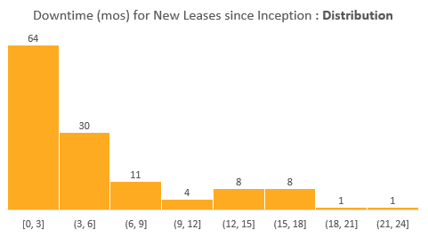
Portfolio Downtime since Inception | How is actual Downtime trending?
74% of signed new leases between signed since inception both the funds have a downtime < 6 months. This is in-line with the standard leasing assumption used in UW.
~22% of signed new leases since inception exceeded UW downtime.
39% of the leases that exceeded UW downtime occurred in the past year.
The data set represents ~127 new leases signed since inception.

Slide 27
Portfolio Downtime since Inception | How is actual Downtime trending?

Slide 28
Tenants Lost | Impact on Renewal Rate (Fund 2 & Fund 3)
The past quarter saw a total of 19 tenant move-outs across markets, varying in size ranges. Four of the move-outs were a result of a business closure/financial difficulty and one was the result of an eviction.

Slide 29
AR (Operational Overview)

Slide 30
Fund 3 | Tenant AR Summary
How are the tenants from Q4 trending?
All Level 3 tenants from 4Q24 (11) made payments to reduce their balances and the trend in 1Q25 is due to Xcision Medical (MD) being added with a 60+ day balance of $90K.
Level 4 tenants have predominately stopped accruing significant balances, going from $446.5K to $386K, driven by Xcision Medical (MD) moving to a Level 3 tenant.
Level | Description
0 | No Balance
1 | Administrative
2 | Disputes
3 | Payment Plans/Watchlist
4 | Eviction / Past Tenant
New Activity emerging in Q1
No new tenants added to the Level 4 default pool
1 new tenant added to the Level 3 payment plan pool
Xcision Medical in Baltimore- prior Level 4, paid $153K in 1Q25 and downgraded to a Level 3 tenant.
Provo Ventures LLC in Baltimore – New TT, Security Deposit remains uncollected
1 new tenant added to the Level 2 dispute pool
Railway Products Group, Inc. in Baltimore – Dispute tied to sprinkler work and seller escrow with TT believing they have a rent credit

Slide 31
Fund 3 | Level 3 & 4 Tenants
Status​ | Property​ | Tenant​ | Credit Score | Area | In-Place Rent​ | Q3 24 Risk​ | Q4 24 Risk​ | 0-60 Days Balance​ | 60+ Days Balance​ | Notes​
Active​ | 2220 Chemsearch Blvd (3tx00004) | Blackbeard Marine, Inc. (t0000980) |  | 38,667 | $7.59 | 4 | 4 | $0 | $255,974 | Apollo Tenant- Vacated unexpectedly; Lawsuits initiated.
Active​ | 1801 S. GSW Parkway (3tx00002) | Melissa Cueller and Jeffrey Scott Crocoll, dba MT Training Center (t0000948) |  | 18,095 | $7.54 | 4 | 4 | $1,456 | $107,449 | Termination agreement fully executed effective 1/7/2025. Tenant did not submit payments per agreement and AMs filed lawsuite to attempt to collect.
Past​ | Multiple​ | Multiple (4 Tenants) ​ |  | ​ | ​ | 4​ | 4​ | $4,455 | $22,487 | All tenants have moved out. Most of the balance is anticipated to be collected
Active​ | 9176 Red Branch (3md00001) | Xcision Medical Systems, LLC (t0000841) | 3 | 17,901 | $10.09 | 3 | 3 | $61,885 | $90,021 | Previously Level 4 at mid-qtr checkin due to pending Eviction. Tenant paid $129K in February with another $60K payment due in March and entered into a new lease with favorable Landlord language upon default
Active | 7120 Ambassador Road (3md00004) | Provo Ventures LLC (t0001058) |  | 16,261 | $10.25 | 3 | 3 | $0 | $17,268 | Security Deposit not collected as of 4/21/25
Active | 14735 NW 25th Court (3fl00001) | Caricom Freight Consolidators, Inc. (t0000782) |  | 25,327 | $10.35 | 3 | 3 | $62,884 | $17,110 | TT Paid $85K in 1Q25. Payment Plan in place collecting +$16k/month and tenant should be current by June 2025
Active | 13001 NW 38th Ave (3fl00009) | Gemcap Investments, LLC (t0001169) | 4.5 | 27,000 | $12.22 | 3 | 3 | $16,431 | $16,387 | Tenant softness identified and is paying monthly and catching up on outstanding chages. Collection anticipated
Active | 70-82 McKee Drive (3nj00019) | Six Thirteen Originals, LLC (t0001112) | 6.0 (Light) | 63,261 | $12.00 | 3 | 3 | $45,773 | $4,383 | NYL Tenant- TT current but for late fees and PY CAM charges. 3 NSFs in 4Q24 and potential dispute on PY charges
Active | 12900 NW 38th Ave (3fl00010) | BES Associates, Corp. (t0001165) | 5.5 | 25,050 | $12.16 | 3 | 3 | $20,355 | $2,041 | Blackstone TT- Tenant Softness Identified; TT Paying Monthly and collection on past due late fees not anticipated
Active | 3276 Democrat (3tn00003) | Lanter Distributing, LLC (t0000899) |  | 45,000 | $3.63 | 3 | 3 | $51,682 | $0 | Watchlist Tenant; Habitual late payer; AM was awarded judgement (pending appeal) and is demanding payment. If tenant gets current, judgement would be in place for the remaining lease term.
Active | 4390 Westroads Drive (3fl00006) | Gorilla Rides LLC (t0001010) |  | 17,280 | $14.40 | 3 | 3 | -$201 | $0 | Apollo Tenant- Landlord approved Sublease and tenant is now current. Monitoring for future AR issues
Active | 9176 Red Branch (3md00001) | Philip Franklin Heiliger & Nany Patricia Heiliger (t0000840) |  | 4,646 | $14.04 | 3 | 3 | $525 | $0 | Watchlist Tenant, small retail TT, piano refabrications & constant late payer. Current as of 1Q25 but monitoring
Active | 4105 S Mendenhall Road (3tn00010) | KPower Global Logistics, LLC | 4 | 102,500 | $3.24 | 3 | 3 | $79,219 | $0 | With Legal- Habitual Late Payer. Headquarters location and collection anticipated. Court date scheduled in 2Q25
Active | 70-82 McKee Drive (3nj00019) | Six Thirteen Originals, LLC (t0001112) | 6.0 (Light) | 63,261 | $12.00 | 3 | 3 | $0 | $4,981 | NYL Tenant- TT current but for late fees. 3 NSFs in 4Q24- Watch listing for future AR issues.

Slide 32
AR Monitoring | Loan Pools
The Apollo Loan has 2 tenants that are being monitored
Blackbeard Marine, 2200 Chemsearch, Texas
Level 4
TT Vacated and lawsuit filed to attempt collection
Gorilla Rides, 4390 Westroads, Florida
Level 3
LL approved sublease and now TT is current
The Blackstone Loan has 3 tenants that are being monitored
BES Associates, 12900 NW 38th Ave, Florida
Level 3
Watchlist tenant but no major balance issues as of 1Q 25
Vision Technologies, 6704 Curtis, Baltimore
Level 2
CAM related, AM verifying accuracy of charges
Northstar Trading, 3380 Grand Ave, Chicago
Level 2
CAM related, TT disputing PY insurance charge, balance late fees likely not collectable
The New York Life Loan has 1 tenant that are being monitored
Six Thirteen Originals, 70-82 McKee Drive, Northern NJ
Level 3
Multiple NSF's in 2024, no major balance issues as of 1Q 25
Lender | Property | Market | Lease | Area | Q4 24 Tenant Risk | 0-60 Owed | 60+ Owed | Total Owed
Apollo | 2220 Chemsearch Blvd (3tx00004) | Texas | Blackbeard Marine, Inc. (t0000980) | 38,667 | 4 | $0 | $255,974 | $255,974
New York Life | 70-82 McKee Drive (3nj00019) | Northern NJ | Six Thirteen Originals, LLC (t0001112) | 63,261 | 3 | $45,773 | $4,383 | $50,156
Blackstone | 12900 NW 38th Ave (3fl00010) | Florida | BES Associates, Corp. (t0001165) | 25,050 | 3 | $20,355 | $2,041 | $22,396
Apollo | 4390 Westroads Drive (3fl00006) | Florida | Gorilla Rides LLC (t0001010) | 17,280 | 3 | ($201) | $0 | ($201)
Blackstone | 6704 Curtis (3md00002) | Baltimore | Vision Technologies LLC (t0000936) | 48,083 | 2 | $12,607 | $24,975 | $37,583
Blackstone | 3380 Grand Ave (3il00004) | Chicago | Northstar Trading LLC (t0000986) | 46,156 | 2 | $11,797 | $12,345 | $24,142

Slide 33
Financial Overview

Slide 34
Balance Sheet
Key Takeaways
Operating Properties:
In Q1-25, the fund acquired 10 properties for a total cost of approximately $87M.
The total FMV of operating properties is $1,288M. Total cost (1.184M)
In Q1-25, the fund sold 1 property (631 S Royal Lane) for $9M, resulting in a $325k loss after closing.
21 properties (3 were valued for the first time) to a total of $264.4M, reflecting a $2.9M (1.6%) value increase compared to the purchase price(or last appraisal value) of $260.3M.
Approximately 62% of the portfolio has been appraised (based on purchase price), accumulating $100M of unrealized fair value gains since inception. (more details)
Development Portfolio:
In Q1-25, the fund continued work on the four development deals, adding $4.3M to the work in progress. Most of the work, $3.2M, was completed at Hazel Park.
Cash:
The decrease in cash is due to being more proactive with a new approach utilizing our revolver more often. In addition, we received $2M Apollo CAPEX escrow release in January.
Derivative Instruments:
Consists of 3 CAPs and 2 SWAPs purchased in 2022 which cover a notional amount of $182M
The decrease in FV as of March 2025 is related to the current changes in the market conditions (SOFR Interest Rate)
1
2
1
3
4
2
3
4

Slide 35
Balance Sheet
Key Takeaways
Loans
$663.5M Outstanding loans (including $72.5M Revolver + 150M Subline + 175 Term Loan + 266M Refis) , less deferred financing costs of $7.0M.
The weighted average LTC (excluding Subline) in Q1-25 was 46% (49% in Q4-24).
The weighted average LTC including the Subline in Q1-25 was 58% (60% in Q4-24).
Carried Interest Liability - The promote is based on 12/24 NAV, as the 3/25 promote was not approved yet.
Equity – Limited Partners
As of 3/25 the total contributions are $565M, increase of $100M from PQ, which is 64% of the $884M Fund’s total commitments (excluding non-controlling interest commitments).
Non-Controlling Interest
$40.1M related to Morgan Stanley investors, represents 49% out of the equity of NWBC JV.
$3.0M related to the partners in the 3 development JVs, (majority $1.9M Joyce Kilmer), represent 10% of the equity in those entities
5
6
5
7
6
7

Slide 36
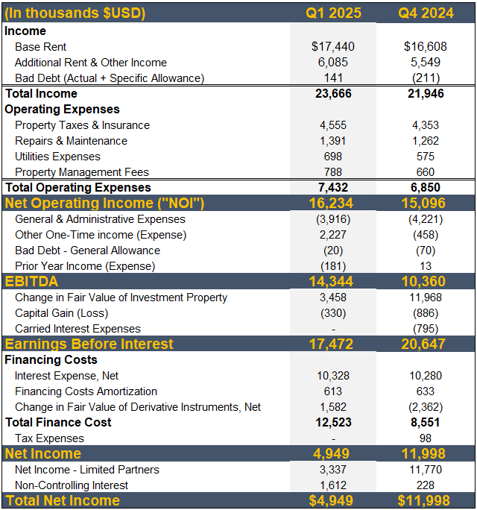
Profit & Loss
Key Takeaways
NOI –
There was a $1.1M increase in NOI due to property acquisitions during the period.
G&A –
G&A expenses include $2.7M in management fees. In 2025, total recurring G&A (excluding commitment fees) is 1.2M.
Other one-time expense –
This includes the $2.2M termination fee from evicted or terminated tenants.
Change in Fair Value of Investment Property –
In Q1-25, 21 properties were appraised (3 were valued for the first time).
The overall increase in the FMV was 1.6% compared to the last appraisal value/PP. (more details)
Realized Capital Gain –
In Q1-25, the fund sold 1 property (631 Royal) for $9.0M, resulting in a $330K loss after closing costs. (more details)
Interest Expense –
The Base Interest Rate in Q1-25 was 5.92%, down from 5.99% in Q4-24.
The EIR, which includes unused fees, financing cost amortization, and cap amortization, was 6.58% in Q1-25, down from 6.69% in Q4-24.
As of quarter end, the fund was 68% hedged (87% excluding the subline).
The fund is going to enter several additional hedges. As of April 22nd, we have entered two $75M hedges, over the coming weeks we will enter additional hedges.
1
2
3
1
4
2
3
4
5
5
6
6
Notes:
Corrected

Slide 37
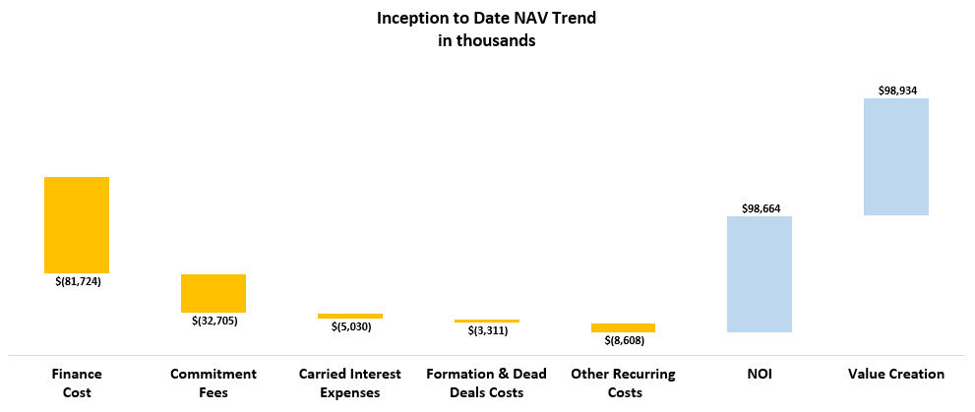
Inception to Date Gain Breakdown - NAV Trend
Outstanding Equity
$663,492
Equity Called
$597,272
Key Takeaways
The fund's net income stands at $66M since inception, which is 11.1% over the Equity contributions. This has been driven largely by the growth in the value of portfolio properties.
Without the impact of $94M increase from appraisals (and the promote), the NAV would experience $28M deficit (i.e., J curve), which is negative 4.6% over the Equity contributions.
The Equity Called is including minority interest contributions (Morgan Stanley, Development JVs partners)
The fund's financial costs include interest expense, unused fees, SWAP & Cap settlements, financing cost amortization, and bank fees.
Formation costs, notably legal fees to Gibson Dunn, represent a significant amount of this expenditure
Other recurring costs are diverse and include legal fees, tax consulting, administrative expenses, software costs, travel and other operating expenses

Slide 38
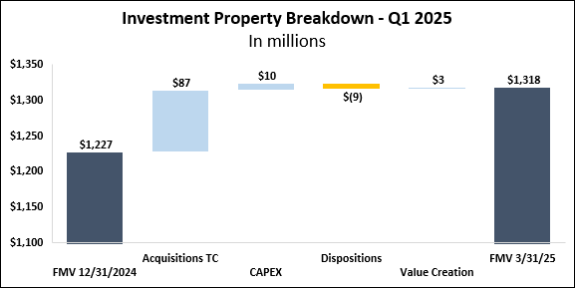
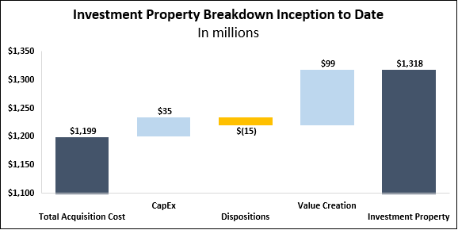
Investment Property Breakdown
Key Takeaways
Key Takeaways
Approximately 62% of the portfolio has been appraised based on the purchase price.
The fund properties' Fair Market Value stands at $1,318M, which is 6.8% higher than the total cost (including CAPEX), which amounts to $1,234M.
In Q1-25, the Fund acquired 10 properties for a total cost of $87M, invested $4M in development projects, and $6M in CAPEX.
During Q1-25, 21 properties were appraised, and 1 property was sold.
The Q1-25 value creation of approximately $3.2M includes a Q1 gain from appraisals of approx. $4.6M, offset by acquisition closing costs of approximately $1.1M and realized loss of $0.3M.

Slide 39
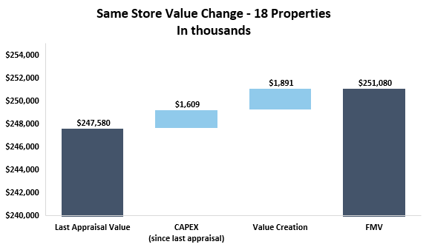
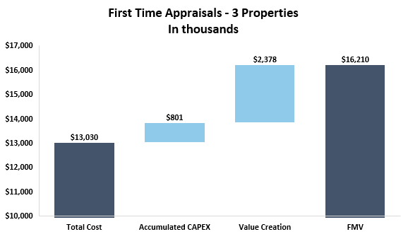
Q1 2025 First Time Appraisals
Key Takeaways
In Q1-25, 21 properties were appraised with a value creation of approximately $3.5M ($4.6M gain less $1.1M acquisition closing costs).
Among these, 3 properties were appraised for the first time, showing a value increase of around $2.4M, representing a 17.2% gain over total cost and accumulated CAPEX of $13.8M.
The remaining 18 properties, which had been appraised before, showed a minimal value increase of $1.9M. Since inception, these properties have increased in value by approximately $26.9M, which is a 12% gain over total cost and accumulated CAPEX.

Slide 40
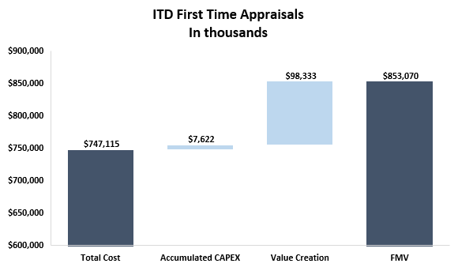
Q1 2025 First Time Appraisals
Key Takeaways
Approximately 62% of the portfolio has been appraised (based on purchase price).
Since inception, the fund has seen a $98.3M value creation from first time appraisals, which represents 13% gain over total cost and accumulated CAPEX. This is in line with the trend we’ve seen across our funds.

Slide 41
Disposition Activity Overview
READY FOR REVIEW –
Fund Finance
Key Takeaways
The Fund has sold three properties, generating $15M in net sale proceeds (after closing costs). The Fund has a capital loss for inception to date of $1.2M.
Additionally, the Fund has incurred a net realized capital gain of $1.4M. This gain is calculated by subtracting the book value of the properties from the net sale proceeds.
In Q1 2025, the Fund completed the sale of one property, generating $8.6M in net sale proceeds (after closing costs).
The property sold was 631 South Royal in the Dallas market with a capital loss of $325k.
The property, acquired as part of a Link Texas portfolio in Q4 2022, was a nonstrategic asset for Faropoint.

Slide 42


Properties NOI Actuals ⁽¹⁾ vs. Budget
Key Takeaways
NOI is aligned with the budget. See further details regarding slight variances below:
Additional Rent – Additional rent higher than budget mainly due to projects billed back to the tenants.
Other Income – Higher Other Income mainly due to:
Late Fee Income not accounted for in the budget for late paying tenants
Repairs and Maintenance – Lower R&M than budgeted mainly due to the timing of the projects
Utilities Expenses – Electricity and water/sewer were higher than expected due to timing differences.
1
2
1
3
4
2
3
4
$1,174M
Total Cost
136
Buildings
Above figures exclude any disposed properties.
Notes:
To summarize - add a line – YOC –Including developments – excluding developments.

Slide 43
Same Store ⁽¹⁾ Analysis
Key Takeaways
1
The increase in NOI is mainly due to collection of previously written off revenues as well as increases in additional rent.
Base Rent and Concessions – increase is mainly driven by two new tenants.
Additional Rent – increase is mainly driven by updated assumptions for budgeted RET increases.
Bad Debt Expenses – the primary driver of this change is collections received from two tenants, significantly impacting overall figures.
2
1
2
3
3
$1,013M
Total Cost
114
Buildings
*Note: Physical Occupancy adjusts for tenants who are in spaces but not currently paying prior quarters.
Above figures exclude any disposed properties.
Notes:
93.2% physical occupancy –take language from Fund 2 89.6%

Slide 44
READY FOR REVIEW –
Fund Finance
Properties Performance
Physical Occupancy
92.1%
89.6%
89.5%
89.2%
89.6%
93.2%
Key Takeaways
YOC increased significantly due to the acquisition of the NNJ portfolio at YOC >6.5%
Slight decrease to YOC in Q2 2024 due to an increase in the operating expenses, mainly insurance and utilities
YOC decrease in Q4-24 mainly due to an increase in operating expenses, mainly due to duplicate insurance expenses. In H2-24, the Fund acquired 41 properties with an in place acquisition YOC of 5.5%.
YOC slight increased in Q1-25 due to increase in same store NOI as explained in the previous slide.
*the WATC is excluding development projects.
** 2024 YoC% was adjusted to reflected the fair share of the Cam Reconciliation for that period.
Notes:
Update physical occupancy

Slide 45
Properties Performance
Key Takeaways
2024 Q1: YOC increased significantly due to the acquisition of the NNJ portfolio at YOC >6.5%
2024 Q2: Slight decrease to YOC in Q2 2024 due to an increase in the operating expenses, mainly insurance and utilities
2024 Q4: YOC decrease in Q4-24 mainly due to an increase in operating expenses, mainly due to duplicate insurance expenses. In H2-24, the Fund acquired 41 properties with an in place acquisition YOC of 5.5%.
2025 Q1: YOC slight increased in Q1-25 due to increase in same store NOI as explained in the previous slide.
Physical Occupancy
92.1%
89.6%
89.5%
89.2%
89.6%
93.2%
*the WATC is excluding development projects.
** 2024 YoC% was adjusted to reflected the fair share of the Cam Reconciliation for that period.
Notes:
Update physical occupancy

Slide 46
Fund Performance | Non-GAAP KPIs
Key Takeaways
The FFO for Q1 2025 is $1.4M, which represents 0.3% of the $536M of WA Equity Core FFO is increased by the effect of the management fees that are being paid based on commitments ($916M) even though the WA Equity is only $536M. In addition, $145.6M weighted avg subline balance at 6.3% interest rate drives down FFO while boosting IRR
Actual Core FFO for the quarter is 2.5M, which represents 0.5% of the $536M WA equity Excluding $1.2M of commitment fees and add back only mgmt. fees on $536M equity.
The expected Core FFO is $2.8M which represents 0.6% of the Theoretical Equity of $471M (assuming 60% LTC). Theoretical G&A Adj: Applies G&A of 0.5% against only the $471M theoretical equity. Theoretical Management Fees Adj: Mgmt. fee % applied only against the $471M theoretical equity Theoretical Interest Expenses Adj: This applies interest rate to 60% LTC debt balance which decreases core FFO as we operate in less than 60% LTC
Notes:
Expected Core FFO with the current yield on cost and interest environment under the assumption of full deployment and

Slide 47
Fund Performance | Non-GAAP KPIs
Key Takeaways
Core AFFO is ($2.7M) which represents (0.5%) of the of the $536M WA equity
Including $5.8M CAPEX invested in the quarter
Excluding $633k non-cash financing cost amortization and change in bad debt allowance

Slide 48
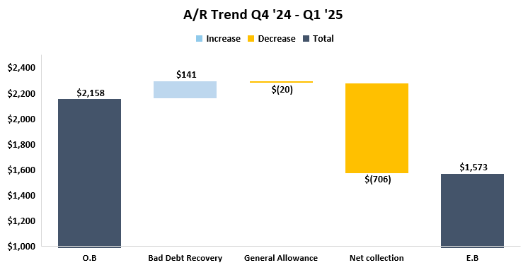
A/R Trend Summary
Key Takeaways
AR balance improved in comparison to PQ mainly due to collections of CAM Reconciliation included as well as other net collections detailed below.
Bad Debt Recovery:
Composed of collections from previously written off AR mainly from the following two tenants:
Xcision Medical at 9176 Red Branch – made payments since PQ
BES Associates at 12900 NW 38th Ave – made payments on written off late fees
General Allowance
Calculated in accordance with the General Allowance methodology, slight increase in line with the overall increase in AR balance QoQ
Net Collections
In the CQ, collections were greater than new tenant billings.
As part of the technical billing cycle in Q1’25, $190K was recorded as revenue but later reversed as part of a Specific Bad Debt Allowance provision, after it was determined that collection was not probable.
1
2
3
1
2
3
Notes:
Bad Debt Recovery:
Composed of collections from previously written off AR mainly from the following two tenants:
Xcision Medical at 9176 Red Branch – made payments since PQ
BES Associates at 12900 NW 38th Ave – made payments on written off late fees
General Allowance
Calculated in accordance with the General Allowance methodology, slight increase in line with the overall increase in AR balance QoQ
Net Collections
In the CQ, collections were greater than new tenant billings.
As part of the technical billing cycle in Q1’25, $190K was recorded as revenue but later reversed as part of a Specific Bad Debt Allowance provision, after it was determined that collection was not probable.

Slide 49
A/R Specific Allowance - Deep Dive

Slide 50
Financing Metrics | Cash Basis vs Effective Interest Rate by Loan
Key Takeaways
The base interest of the fund is 5.92% after taking a weighted average across all loans (including the subline) and applying hedging
When also factoring in financing costs amortization & unused fees, the effective interest rate is 6.58%
As of quarter end, the fund was 68% hedged (87% excluding the subline).
In anticipation of our refi closing at the end of June, the fund is going to enter into several additional hedges. As of April 25nd, we have entered into two $75M hedges, over the coming weeks we will enter into additional hedges.
The weighted average LTC in Q1-25 is 46% (excluding subline). The weighted average leverage including subline was 58%
LTC
52%
58%
61%
63%
* The Cap and SWAP hedging effect is associated with the credit Facility.
Notes:
Split out subline and credit facility – LTC including additional availability – Last compliance file – what is the availability. Rather than outstanding amount. 3/31 S&U FPR quarter end

Slide 51
Main Debt Covenants Overview
Loan | Covenant | Threshold | NOI Basis | NOI Adjustments | Q1 2025 Value | Q1 2025 YOC % | Occupancy*
Apollo | Debt Yield | 8.75%, 9.00%, 9.25% | T12 | 5% Vacancy / Credit Loss | 10.5% | 6.24% | 96.7%
New York Life | Debt Yield | 8.50% | Current Qtr x4 | $0.15 SF Reserves | 11.5% | 6.98% | 98.8%
Blackstone | DSCR (Debt Yield) | 1.25x (8.16%) | Net CF/ Debt Service | AR Adj | 1.51x (9.9%) | 6.26% | 100%
Credit Facility | Implied DSCR | 1.30x | T12 | $0.15 SF AR 60+ | 1.89x | 5.45% | 88.9%
Fund level | FCCR | 1.50x | T12 | N/A | 1.73x | 5.52% | 93.2%
* Occupancy figures are physical occupancy for Apollo, NYL, and BX, acquisition occupancy for Credit Facility, and adjusted occupancy for Fund Level

Slide 52
Development Deals| Project Analysis
1
2
3
4
Key Takeaways
1
Joyce Kilmer -
The total actual contribution is higher than the expected because the loan had not closed yet at time of contribution. To fund the construction, we made additional contributions. We will receive proceeds once the loan is finalized and spent 39% of the budget.
With 90% of entitlements secured, demolition of existing buildings will start on June 1st when the tenant vacates.
Hazel Park 295 (30% Completed) –
JV has called 80% of all contributions and has spent 34% of the budget.
The project is currently under construction and the building envelope is set to be completed in Q2. A construction loan was closed on April 14th with Pinnacle Bank.
Lincoln Swisher –
JV has called 66% of the total contribution and has spent 20% of the budget.
Full approvals to start construction work in the next 4-6 weeks.
Swedesboro -
Land clearing began in mid-March. Site improvements are scheduled to start in mid-May .
2
3
4

Slide 53
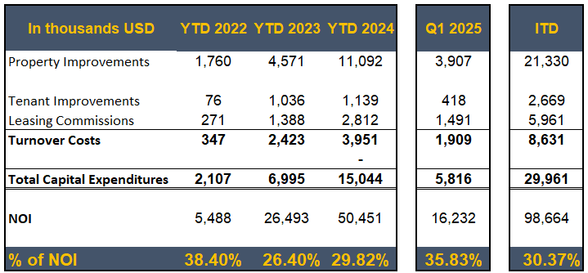

CAPEX, Tenants Improvements & Leasing Commissions
Key Takeaways
Turnover Costs represent the estimated obligations incurred in connection with the signing of a lease; including leasing commissions and tenant improvements.
CAPEX of Q1-2025 of $5.9M, which represent 36.3% out of the Fund’s NOI
Main investments:
Interior build out on the renovation of 120-200 Adams ($900K) and 4450 Alpha Rd roof repairs ($630k).
Leasing commissions for a 10-year lease for the Beard Integrated Systems lease at 1501 Kings (TX)-($925k) and renewal of a lease at 1400 Beaver (GA). ($250K)
Inception to date the Fund invested $30.1M CAPEX, which are 30.45% out of the NOI.
Property Improvements per square foot (SF) is calculated as Property Improvements for the quarter divided by the WASF (Weighted Average per Square Foot) for the period.
Property Improvements includes non-recoverable CapEx items + CM Fees.

Slide 54
Termination Fee
Audited Financial Statement: Proceeds Recorded as Revenue, Boosting Net Income
FPR: Proceeds Typically Excluded from Non-GAAP KPIs (FFO/NOI)
Key Bank Covenant Calculation: NOI Excluded; EBITDA Included
In the audited financial statement, termination fees will increase both the fund's revenue and net income.
As a reminder, Non-GAAP KPIs like NOI and Core FFO are not presented in the audited financial statement
The internal KPIs are based on management's definitions and are not governed by IFRS or US GAAP.
Since termination fees are a one-time income, they will be excluded from Core FFO and NOI.
However, in cases where the termination fee compensates for loss of income, the relevant amount may be included in the non-GAAP KPIs, as determined by management.
Under the credit agreement definition, termination fees are excluded from NOI in the Implied DSCR test for availability determination.
However, per the credit facility agreement, termination fees will be included in EBITDA ( which is used for FCCR Test )if they are part of net income in the audited financial statement (which applies here).
Notes:
The $200k payment covers the lessee’s obligation for restoration repairs, HVAC units fire safety inspection reimbursement. The agreement regarding this was the lease termination agreement – executed 3/3/2025 – Remaining lease term was 18 months. The $2M payment is the present value of 55% of the base annual rent and total estimated additional rent for the remainder of the lease term. The agreement regarding this is the first amendment to the lease executed on 9/25.

Slide 55
BS Exhibit
Key Takeaways
1
Aggregate cash for fund operating account and property operating accounts. Maintained in JPM, KeyBank and Citizens
Funds held by the various development JVs and MS Co-Invest.
Cannabis tenant – per KeyBank – cannot use these funds
2
3
1
2
3

Slide 56
Sources & Uses

Slide 57
Sources and Uses – Next Capital Call ⁽¹⁾
Key Takeaways
As of today, the fund has enough resources to fund all the deals in the pipeline other than Maple Tree.
In anticipation of Maple Tree Closing, we are proposing a potential additional capital call for $274M for late May/early June, with funding mid June. Proceeds will be used for the acquisition of Maple Tree, which is scheduled to close late June.
This capital call will bring us to 95% of all commitments, maintaining a 5% fund reserve.
Since the Refi is expected to be closed in early July, we are expecting to receive temporary additional commitment on the Credit Facility from KeyBank for $100M.
After the acquisition of Maple Tree, the Fund will pause future acquisitions until Maple Tree is stabilized.
(1) The above schedule omits future capital needs for development as separate development loans will be entered.
*The total projected credit facility availability will be reliant on the total DSCR as well as the additional $100M bridge loan.

Slide 58
READY FOR REVIEW –
Fund Finance
Sources and Uses | End of Q1 -25
As of 3/31, the fund acquired properties with a total cost of $1.197M ITD and $84M QTD. As of quarter end, there was another $130M of identified deals for April.
There were $597M in equity calls, including $100M call in the current quarter. Approximately 64% of all commitments have been called.
Currently, the fund has $664M in outstanding debt.
Notes:
Timing of capital call – weve never done one this size before
Roi opinion on days between capital call and maple tree closing
Early/mid June - mid July is the best ballpark we have right now

Slide 59
Fund Hypothetical Performance Forecast | Credit Facility Collateral Pool Covenants
Covenant | Min/Max | Before Refi – All Properties | After Refi – All Properties | Before Refi – W/ Exclusions¹ | After Refi – W/ Exclusions¹
Debt Availability² | >$175M | $617.3M | $349.5M | $631.1M | $361.1M
Occupancy | >85.0% | 89% | 83% | 93% | 90%
Collateral Pool Value | >$300M | $1,254M | $748M | $1,175M | $694M
Collateral Pool Properties³ | >30 | 137 | 90 | 127 | 82
WALT | >2.0 | 2.7 | 2.2 | 2.9 | 2.4
Tenant Concentration | <15.0% | 2.9% | 5.1% | 3.0% | 5.2%
Single Property Concentration | <15.0% | 3.0% | 4.4% | 3.2% | 4.7%
MSA Concentration | <30.0% | 17.0% | 18.8% | 18.1% | 20.2%
Removes vacant properties with negative T12 NOI from the credit facility pool.
Uses T12 NOI as of Q2 2025.
Uses the 12/31/2024 FMV for same store assets plus the estimated purchase prices of identified future acquisitions and less estimated sale prices of identified future dispositions

Slide 60
Fund Hypothetical Performance Forecast | Sources & Uses
Source |  | 3/31 Model Forecast | After Mapletree | After Refi
Total Cost⁽¹⁾ |  | $1,231M | $1,715M | $1,762M
Other Uses & Cash |  | $45M | $50M | $56M
Total Uses |  | $1,276M | $1,765M | $1,818M
Total Equity Called |  | $595M | $869M | $869M
Fixed Refis | Apollo (100% hedged) | $94.5M | $94.5M | $94.5M
 | NYL (100% hedged) | $90M | $90M | $90M
 | Blackstone (100% hedged) | $81.5M | $81.5M | $81.5M
 | Subtotal | $266M | $266M | $266M
Credit Facility | Term Loan (100% hedged) | $175M | $175M | $175M
 | Revolver ($7M hedged) | $90M | $355M | $98M
 | Bridge Loan | $0M | $75M | $0M
 | Subtotal | $265M | $605M | $273M
Development Loans |  | $0M | $3M | $17M
New Refi |  | $0M | $0M | $370M
Subline |  | $150M | $23M | $23M
Total Debt |  | $681M | $896M | $949M
Total Sources |  | $1,276M | $1,765M | $1,818M
TC calculation uses actuals as of 12/31/2024 and forecasts going forward. The calculation also includes identified future acquisitions and dispositions.

Slide 61
Fund Hypothetical Performance Forecast | Identified Acquisitions
Key Takeaways
The fund is expected to close on $578M of assets totaling 3.5M SF in 2025
YTD there have been $86M of assets acquired, with an additional $492M expected to close by the end of Q3 2025
Asset Name | Area (SF) | Purchase Price | Acquisition Date
Inland Empire Portfolio | 242.2K | $63.6M | 4/8/2025
750 District Dr | 50.8K | $5.0M | 4/14/2025
3801 Hawthorne Ct | 194.4K | $13.9M | 4/16/2025
6951 Alan Schwarzwalder St | 60.0K | $4.6M | 5/2/2025
411 Sinclair Rd | 57.1K | $7.4M | 5/5/2025
2405 S Shiloh Rd | 60.5K | $6.7M | 5/5/2025
Atlanta Hart Portfolio | 134.9K | $15.3M | 5/14/2025
14550 58th St N | 40.5K | $6.8M | 5/20/2025
1500 Birchwood Ave | 20.0K | $1.8M | 5/20/2025
1299 Boltonfield St | 144.0K | $12.1M | 5/30/2025
625 Joyce Kilmer Ave | 25.4K | $4.1M | 6/9/2025
Mapletree Portfolio | 1.78M | $331.0M | 7/1/2025
935 Bronx River Ave | 36.0K | $13.1M | 7/15/2025
2 Eastmans Rd | 31.0K | $7.2M | 9/1/2025
Total | 2.87M SF | $492.5M
Identified Acquisitions
Q1 2025* | $86.0M | 0.6M SF
Q2 2025 | $141.1M | 1.1M SF
Q3 2025 | $351.4M | 1.8M SF
Total | $578.5M | 3.5M SF
*Assets have been closed

Slide 62
NWBC JV, LP Co-Investment with Morgan Stanley

Slide 63
Profit & Loss
Key Takeaways
NOI is consistent with a slight decrease to PQ, but inline overall with the budget.
In Q1-25, all 10 properties were appraised with an overall gain.
1
2
1
2
Notes:
While total income had a notable increase total operating expenses have increased as well.

Slide 64
Fund Performance | Non-GAAP KPIs
Key Takeaways
The FFO in Q1-25 is $0.9M, which represent 6.1% of the $59M Equity.
The Core FFO for the period is $0.8M, which represents 5.4% of the equity.
The Core FFO is decreased by the effect of excluding Other Income & Prior Year Adjustments.
The AFFO for the period is ($0.04M), which represents (0.3%) of the equity.
AFFO decreased mainly due to $950k of CAPEX costs – there are ongoing CAPEX projects in the portfolio for roofing/HVAC ($1.5M) and tenant improvements ($350k).

Slide 65
Balance Sheet and S&U
Key Takeaways
Based on the analysis above, and assuming we do not want to call for additional funds to cover ongoing CAPEX, we should continue to accumulate our AFFO and not make distributions this quarter.

Slide 66
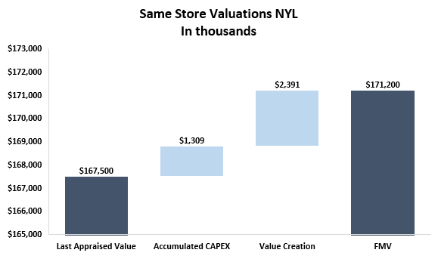
Valuation - NWBC
Key Takeaways
In Q1-25 we appraised the entire portfolio of 10 assets, which resulted in 1.4% value creation since last appraised value.
Consistent with the main fund trend, we see a smaller valuation creation in comparison to the first-time appraisal.
This portfolio of assets is driving the QTD valuation gain, 69% of total gain, and signifies the high-quality assets.
Notes:
To update commentary

Slide 67
Fund Forecast

Slide 68
Fund Performance Forecast | Acquisitions Pace
Key Takeaways
To acquire the $492M of Pipeline Assets in Q2-Q3 2025, 95% of the equity will be called by the end of June 2025 (meaning we will call $274M in June)
There will be $274M of remaining deployment after 2025, ~$174M in 2026 and ~$100M in H1 2027
Notes:
Left graph should be % accumulated equity Deployed (less Equity reserves) and % accumulated Deployment
Right graph is cluster bar graph with $ Deployment and equity

Slide 69
Fund Performance Forecast | Deployment and Capital Call Pace
Key Takeaways
To acquire the $492M of Pipeline Assets in Q2-Q3 2025, 95% of the remaining equity will have to be called (assuming 5% equity reserves) at the start of Q3 2025 (or at the end of Q2, depending on Mapletree timing)
There will be $274M of remaining deployment after 2025, ~$174M in 2026 and ~$100M in H1 2027
Reflects 5% equity reserves
Notes:
Left graph should be % accumulated equity Deployed (less Equity reserves) and % accumulated Deployment
Right graph is cluster bar graph with $ Deployment and equity

Slide 70
Fund Performance Forecast | Identified Acquisitions
Key Takeaways
The fund is expected to close on $578M of assets totaling 3.5M SF in 2025
YTD there have been $85.5M of assets acquired, with an additional $492M expected to close by the end of Q3 2025
Asset Name | Area (SF) | Purchase Price | Acquisition Date
Inland Empire | 242.2K | $63.6M | 4/8/2025
750 District Dr | 50.8K | $5.0M | 4/14/2025
3801 Hawthorne Ct | 194.4K | $13.9M | 4/16/2025
6951 Alan Schwarzwalder St | 60.0K | $4.6M | 5/2/2025
411 Sinclair Rd | 57.1K | $7.4M | 5/5/2025
2405 S Shiloh Rd | 60.5K | $6.7M | 5/5/2025
Atlanta Hart Portfolio | 134.9K | $15.3M | 5/14/2025
14550 58th St N | 40.5K | $6.8M | 5/20/2025
1500 Birchwood Ave | 20.0K | $1.8M | 5/20/2025
1299 Boltonfield St | 144.0K | $12.1M | 5/30/2025
625 Joyce Kilmer Ave | 25.4K | $4.1M | 6/9/2025
Maple Tree Portfolio | 1.78M | $331.0M | 7/1/2025
935 Bronx River Ave | 36.0K | $13.1M | 7/15/2025
2 Eastmans Rd | 31.0K | $7.2M | 9/1/2025
Total | 2.87M SF | $492.5M
Identified Acquisitions
Q1 2025* | $85.5M | 0.6M SF
Q2 2025 | $141.1M | 1.1M SF
Q3 2025 | $351.4M | 1.8M SF
Total | $578.0M | 3.5M SF
*Assets have been closed

Slide 71
Fund Performance Forecast | Dispositions
Key Takeaways
There have been 3 dispositions in the fund to date, with a total sales price of ~$15.8M
The model assumes 10 future dispositions totaling ~$66.8M of sales price before the sale of the fund, largely misfits from the Mapletree portfolio and other select assets with quality or location issues
While we may also exit the Baltimore & Cincy markets, those are not modeled here
Asset Name | Area (SF) | Sales Price | Disposition Date
5425 & 5445 E Raines* | 169.3k | $6.8M | 12/26/2024
631 S Royal Lane* | 51.4K | $9.0M | 1/30/2025
1120 Vend Dr | 24.8K | $2.4M | 6/1/2025
10475 Fortune Parkway (100) | 40.6K | $7.6M | 10/1/2025
10475 Fortune Parkway (200) | 56.9K | $9.7M | 10/1/2025
321 Richard Mine Road | 80.0K | $15.0M | 1/1/2026
645 NW Enterprise Dr | 28.8K | $4.8M | 1/1/2026
651 NW Enterprise Dr | 20.0K | $3.3M | 1/1/2026
625 Joyce Kilmer Ave | 25.4K | $5.1M | 4/1/2026
9 S. Forrest Avenue | 49.9K | $6.1M | 4/1/2027
410 Factory | 41.6K | $3.9M | 4/1/2027
1425 Grandview Avenue | 47.3K | $8.9M | 4/1/2027
Total | 635.8K SF | $82.6M
Can’t be sold until 2026 as assets are in the Maple Tree REIT
Dispositions
Q4 2024* | $6.8M | 169.3k SF
Q1 2025* | $9.0M | 51.4K SF
Q2 2025 | $2.4M | 24.8K SF
Q4 2025 | $17.2M | 97.4K SF
Q1 2026 | $23.1M | 128.8K SF
Q2 2026 | $5.1M | 25.4K SF
Q2 2027 | $18.9M | 169.7k SF
Total | $82.6M | 635.8K SF
*Assets have been sold

Slide 72
Fund Performance Forecast | Yield on Cost
Key Takeaways
In 2025, the fund’s projected YOC is 35bps lower than previously forecasted due to Q1 2025 actuals and low YOC of Mapletree and the other pipeline assets
Even in 2028, the forecasted YOC is 16bps lower than previously forecasted due to the ~7.0% untrended YOC of Mapletree
35bps decrease vs prior model
Notes:
Left graph is clustered bar from Q4 FPR with and without Development deals
Right Graph is clustered bar from Pipeline model with and without development

Slide 73
Fund Performance Forecast | Yield on Cost
Key Takeaways
Yield on cost for the portfolio grows most steeply in late 2026 through 2027, with more of the growth shifted into 2027 than the previous iteration of the model
Overall YOC is lower compared to the previous model due to the low in-place NOI of Mapletree and other pipeline assets
Notes:
Left graph is clustered bar from Q4 FPR with and without Development deals
Right Graph is clustered bar from Pipeline model with and without development

Slide 74
Fund Performance Forecast | CapEx, TI & LC Including Pipeline
Key Takeaways
CapEx PSF is highest in 2026, while TIs are highest in 2026-28 due to lease expirations in 2026-27
For future acquisitions, we assume constant TIs ($ PSF) and LCs (% of NOI) each year, creating less variability in their forecasts
Notes:
Pipeline Model

Slide 75








Financing Strategy & Summary
Key Takeaways
The Fund closed on an $81.5M loan with Blackstone for a pool of 16 properties in September 2024
Capital Call Line remained at $150M
Credit Facility decreased from $274.5M to $247.5M
 | Capital Call Line | Credit Facility | Term Loans
Use | Improve efficiency by streamlining acquisitions, allowing for quarterly capital calls | Provide maximum flexibility during the deployment period. Later to be refinanced into long term debt | Permanent debt against specified stabilized asset batched allows cash management stability and mitigation of cross collateralization
Lender
Interest Rate | Monthly SOFR | Monthly SOFR | 4.10% | 4.00% | 4.63% | TBD
Spread | 1.85% | 1.80%-1.85% | 2.05% | 2.30% | 1.90% | TBD
All-In Rate | N/A | N/A | 6.15% | 6.30% | 6.53% | TBD
Interest Only | Full Term | Full Term | Full Term | Full Term | Full Term | Full Term
Effective Amount Hedged | N/A | $182M | $94.5M (100%) | $90M (100%) | $81.5M (100%) | $340-370M (100%)
Hedged All in Interest Rate | N/A | 5.39% | 6.15% | 6.30% | 6.53% | TBD
Loan Commitments | $150M | $530M | $94.5M | $90M | $81.5M | $340-370M
Effective Used Debt | $150M | $274.5M | $94.5M | $90M | $81.5M | $340-370M
$84.5M
$175M
$90M

Slide 76
Loan & Hedging Maturities
Total Hedged: $182M
3.03% + 1.80% = 4.83%
Cap
$20M
3.30% + 1.80% = 5.10%
Aug ‘22
Aug ‘25
Cap
$51M
3.00% + 1.80% = 4.80%
Nov ‘22
Nov ‘26
Cap
$40M
3.00% + 1.80% = 4.80%
Dec ‘22
Dec ‘29
Swap
$50M
2.54% + 1.80% = 4.34%
Aug ‘22
Jun ‘27
Swap
$21M
4.08% + 1.80% = 5.88%
Nov ‘22
Jun ‘27
Revolver
$355M
Avg. of ~180 bps spread
May ‘22
Jun ‘27
($72.5M Outstanding)
Term Loan
$175M
May ‘22
Jun ‘27
Apollo
$94.5M
4.10% + 2.05% = 6.15%
Oct ‘23
Oct ‘28
NYL
$90M
4.00% + 2.30% = 6.30%
Feb ‘24
Feb ‘29
BX
$81.5M
4.63% + 1.90% = 6.53%
Sep ‘24
Sep ‘29
Only 51% ($46M) remains in Fund III, with the rest being tied to co-invest with Morgan Stanley
May ‘22
May ‘23
May ‘24
May ‘25
May ‘26
May ‘27
May ‘28
May ‘29
May ‘30
We are here – April ‘25

Slide 77
Fund Performance Forecast | Hedging & Debt Forecast
Key Takeaways
Currently, the Fund has $182M of hedging against the credit facility at a 3.03% weighted average SOFR rate with staggered maturity dates from 3Q25 to 1Q29
The Apollo, New York Life, and Blackstone refinances are fixed rate loans, providing additional hedging through the remainder of the fund term
The model uses the all-in rate for the $370M refi of SOFR Fwd Curve +200 bps with a cap at 4.50%
Note: SOFR forward curve as of April 3rd, 2025
Notes:
Pipeline Model

Slide 78
Fund Performance Forecast | Quarterly FFO Forecast
Key Takeaways
Core FFO and AFFO are both significantly lower than the previous version of the model in 2025 and 2026 due to the low in-place YOC of the pipeline properties
Over the next 18 months, we expect to have AFFO of ($12.1M) before stress test
We assume distributions of Core FFO commencing Q1 2026, with CapEx, TI & LC funded by availability growth of the facility properties
Notes:
Left graph is from Q4 FPR model
Right graph is from Pipeline Model

Slide 79
Fund Performance Forecast | Annual FFO Forecast
Key Takeaways
Core FFO and AFFO are both significantly lower than the previous version of the model in 2025 and 2026 due to the low in-place YOC of the pipeline properties
Over the next 18 months, we expect to have AFFO of ($12.1M) before stress test
We assume distributions of Core FFO commencing Q1 2026, with CapEx, TI & LC funded by availability growth of the facility properties
Notes:
Left graph is from Q4 FPR model
Right graph is from Pipeline Model

Slide 80
Fund Performance Forecast | Performance Overview
Key Takeaways
The Fund reaches 17.67% Gross IRR & 13.86% Net IRR over a 7-year hold period (assuming a sale on January 1st, 2029)
The FPR Model and Pipeline Model use exit caps of 5.91% and 5.83% respectively. These were calculated using Mike’s updated exit cap methodology
IRR is highly sensitive to changes in disposition cap rate (i.e., 25bps change to exit cap rate impacts Net IRR by ~170bps)
Q4 2024 FPR Model Jan 1st, 2029 Sale
Pipeline Model Jan 1st, 2029 Sale
Notes:
Left Sensitivity table will be including previously used Exit Cap and the new methodology exit cap in the table with EMs, Sale Prices, GP Promote from Q4 FPR Model
Right Sensitivity table will be including previously used Exit Cap and the new methodology exit cap in the table with EMs, Sale Prices, GP Promote from Pipeline Model

Slide 81
Fund Performance Forecast | DSCR Forecast
Key Takeaways
The DSCR Stress case layers on a 50 bps increase to the 10Y Treasury starting 5/1/2025 and an additional 2% NOI Reduction
Through 2026, the DSCR bottoms out at the 1.33x in the stress case while the base case stays in the 1.42-1.43x range, as we acquire more properties at a level that maintains 1.30x stress test DSCR
The projection uses a 10Y Treasury forward curve of 4.4% as of 4/21/25
Notes:
Left FCCR Forecast will be from Q4 FPR Model
Right FCCR Forecast will be from Pipeline Model

Slide 82
Fund Performance Forecast | FCCR Forecast
Key Takeaways
When including the identified pipeline and future acquisitions, the Pipeline Model closes in on the 1.50x FCCR covenant in Q1 & Q2 2026, indicating a potential covenant issue in the near future
In comparison, the minimum 2026 FCCR buffer reduced from 5 bps in Q4 2024 FPR down to 3 bps now
Notes:
Left FCCR Forecast will be from Q4 FPR Model
Right FCCR Forecast will be from Pipeline Model

Slide 83
Fund Performance Overview | Seed Portfolio Forecast
OPEN –
Corp Finance
Key Takeaways
The assets in the seed portfolio reach 16.8% Gross & 12.6% Net IRR over a 6-year hold period (sale on Jan 1, 2028) and assuming a 5.75% exit cap
Although we plan to sell the fund after 7 years, we evaluate the seed portfolio assets over a 6-year hold since this is roughly the average hold time of all projected fund assets (since assets purchased in 2024-25 will be held for under 6 years)
Core FFO is slightly higher for the seed portfolio than full fund since these assets are purchased earlier
 | End of 2027 | End of 2028
Hold Period Scenarios | 6 Years | 7 Years
Gross IRR | 16.8% | 15.9%
Net IRR | 12.6% | 12.2%
Gross Equity Multiple | 1.75x | 1.93
Net Equity Multiple | 1.57x | 1.72
GP Promote | $48.3 | $60.7
Disposition Cap Rate | Gross IRR 16.8% | Net IRR 12.6%
5.25% | 21.1% | 16.5%
5.50% | 18.9% | 14.5%
5.75% | 16.8% | 12.6%
6.00% | 14.7% | 10.9%
6.25% | 12.7% | 9.6%

Slide 84
Refi Analysis

Slide 85
Fund III Refi Pool | Portfolio ID
Performance Metrics
Properties / Tenants | 47 / 108
Total Size (SF) | 3.93M
Total Purchase Price¹ | $458.3M
Average Price PSF | $116.6
Fair Market Value² | $506.1M
Total Occupancy | 96.5%
WALT³ | 3.3
Key Takeaways
This pool of 47 assets provides strong, consistent performance, with cap rates in the 6.2-7.3% range for each of the next 4 years
97% occupancy, with most rent unlocking 2028 and onwards, reflecting the relatively longer WALT of the portfolio
Long WALTs targeted as to more efficiently retrieve the benefits to debt availability in the credit facility, as the CMBS will be sized without the benefit of future increasing rents
The Total Cost of this pool is $471.1M as of the end of Q4 2024 (including purchase price & acquisition costs of pipeline assets)
Adjusting for the projected boost to FMV from appraisals for properties in the pool, the FMV of the pool is projected to increase to $550.7M
As of 12/31/2024

Slide 86
Fund III Refi Pool | Breakdown by Market
Key Takeaways
The portfolio is well diversified geographically, with the highest concentrations in Atlanta, Northern NJ/NY, and Los Angeles
In total, these 3 markets make up 44% of the total purchase price of the pool
Market | Count | SF (M) | PP (M) | % of Pool
Atlanta | 7 | 0.59 | 69.5 | 15.2%
Baltimore | 1 | 0.06 | 7.0 | 1.5%
Charlotte, NC | 3 | 0.28 | 28.9 | 6.3%
Chicago | 7 | 0.59 | 53.5 | 11.7%
Cincinnati | 2 | 0.29 | 12.9 | 2.8%
Columbus | 4 | 0.38 | 24.9 | 5.4%
Dallas | 2 | 0.20 | 18.7 | 4.1%
Jacksonville | 4 | 0.57 | 62.0 | 13.5%
Long Island | 1 | 0.09 | 17.8 | 3.9%
Los Angeles | 4 | 0.24 | 63.6 | 13.9%
Memphis | 1 | 0.10 | 3.5 | 0.8%
Miami | 3 | 0.12 | 25.1 | 5.5%
Northern NJ/NY | 7 | 0.37 | 67.6 | 14.7%
Philadelphia | 1 | 0.03 | 3.4 | 0.7%
Grand Total | 47 | 3.93 | 458.3 | 100.0%

Slide 87
Fund III Refi Pool | Lease Expiration
Key Takeaways
2028 will be a key focus given the $ amount of rent rolling during those calendar year
Existing pool covenants and quotes received from brokers influenced the WALT composition of the refi pool beyond maximizing debt proceeds
Capex, TI and LCs stay in the $5.1-7.0M range through 2025-27 and peak at $7.5M in 2028

Slide 88
Fund III Refi | Credit Facility vs CMBS Availability
Key Takeaways
We assume $370M CMBS proceeds here, which represents the midpoint of the range shown on the prior page
The Credit Facility has a peak debt availability of $309.5M in Q4 2028 with a balance of $290.9M (6% debt reserves)
Credit Facility loan balance stays ~$60-125M below the CMBS’s fixed balance from 2025 through the end of 2028
Credit Facility reflects ~4.22% 10Y Treasury as of 4/3/25

Slide 89
Fund Impact Analysis | Credit Facility Collateral Pool Covenants
Covenant | Min/Max | Before Refi – All Properties | After Refi – All Properties | After Refi – W/ Exclusions¹
Debt Availability² | >$175M | $617.3M | $349.5M | $361.1M
Occupancy | >85.0% | 89% | 83% | 90%
Collateral Pool Value | >$300M | $1,254M | $748M | $694M
Collateral Pool Properties | >30 | 137 | 90 | 82
WALT | >2.0 | 2.7 | 2.2 | 2.4
Tenant Concentration | <15.0% | 2.9% | 5.1% | 5.2%
Single Property Concentration | <15.0% | 3.0% | 4.4% | 4.7%
MSA Concentration | <30.0% | 17.0% | 18.8% | 20.2%
Key Takeaways
This analysis includes all acquired properties to date plus pipeline properties as of 3/31
After Refi values reflect removal of the Fund III CMBS Refi Pool properties, and No Vacancy pool additionally removes vacant properties with negative T12 NOI
After removing the CMBS properties and vacancies, the occupancy moves above the 85% threshold
Choosing long WALT properties for the CMBS pool, leads the credit facility coming closer to its 2.0 minimum WALT threshold at 2.2
Removes vacant properties with negative T12 NOI from the credit facility pool.
Uses T12 NOI as of Q2 2025.

Slide 90
Appendices

Slide 91
NYL Pool (NNJ Co-Invest)

Slide 92
Yield on Cost & CapEx Forecast | NYL
Key Takeaways
Yield on Cost for our NYL pool grows most sharply in 2028 as many properties unlock during 2027
CapEx and TI/LC stays flat over time, stabilizing near $2M annually
Accumulated CapEx and TI/LC reach $9.6M for the NYL pool by the end of 2028

Slide 93
Debt Yield Covenant Analysis| NYL
Key Takeaways
Debt Yield covenant remains flat at 8.5% throughout the course of the loan
Stryker lease expiration at the end of 2026 results in significant drop to quarterly NOI in Q1 2027 (amplified since the adjusted NOI is calculated by annualizing the quarterly NOI)
Debt Yield Covenant uses the quarters NOI annualized for calculation

Slide 94
Fund Performance Overview | NNJ Co-Invest
Key Takeaways
The co-invest with Morgan Stanley is projected to reach 20.6% Gross & 18.1% Net IRR, assuming sale on Jan 1, 2029 (aligned with full fund), 5.50% disposition cap rate, 1.25% management fee, and 10% GP promote
Distributions CoC% differs from AFFO % since in certain quarters the co-invest will prepare for large upcoming capex events by keeping additional reserves

Slide 95
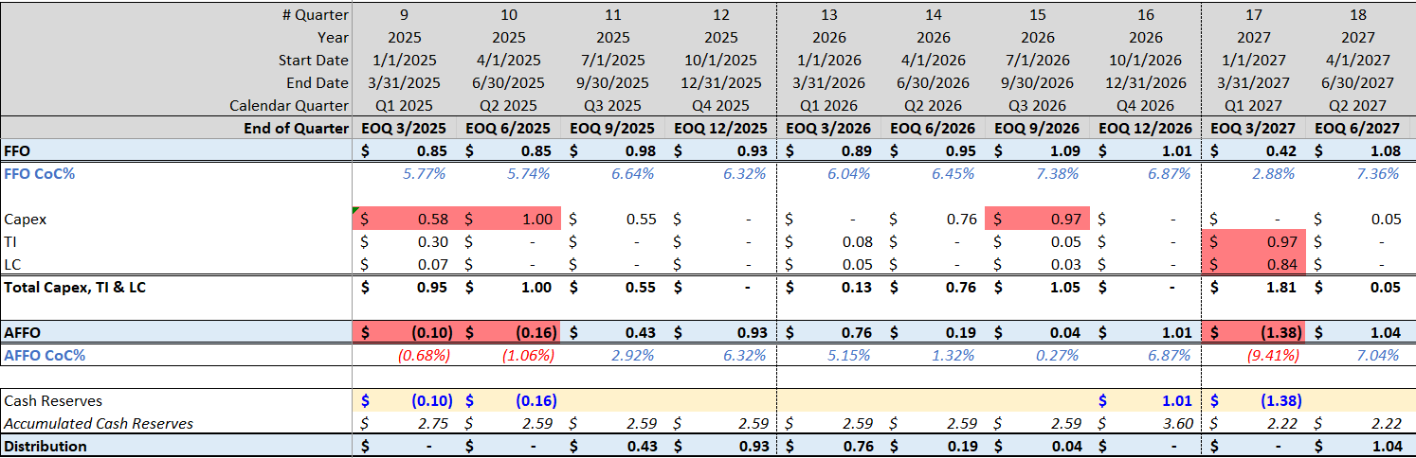
Reserves Policy | Next 30 Months Cashflow Forecast
Key Takeaways
In the next 30 months, we have significant capex events in 2025 through 2027
We will need to set aside reserves in 2026 to cover the negative Q1-27 AFFO
Step 1: Notice upcoming negative AFFO period or large CapEx Events
Step 2: Build cash reserves balance in advance
Step 3: Draw on reserves balance in required period to enable distribution
1
1
3
2

Slide 96
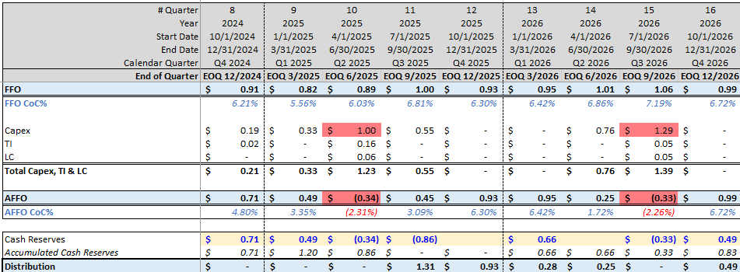
Reserves Policy | Next 24 Months Cashflow Forecast
OLD
OPEN –
Corp Finance
Key Takeaways
In the next 24 months, we have significant capex events in 2025 through 2026
We will need to set aside reserves from our Q4-24 and Q1-25 AFFO, as well as the Q1-26 AFFO
Step 1: Notice upcoming negative AFFO period or large CapEx Events
Step 2: Build cash reserves balance in advance
Step 3: Draw on reserves balance in required period to enable distribution
1
1
2
3

Slide 97
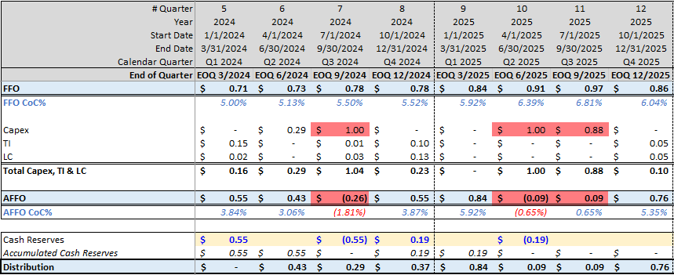
Reserves Policy | Next 24 Months Cashflow Forecast
PLACEHOLDER – TO BE UPDATED
OPEN –
Corp Finance
Key Takeaways
In the next 24 months, we have significant capex events in Q3-24 and Q2 & Q3-25
Because of these, we will need to set aside reserves from our Q1-24 AFFO as well as from Q4-24 AFFO
Step 1: Notice upcoming negative AFFO period
Step 2: Build cash reserves balance in advance
Step 3: Draw on reserves balance in required period to enable distribution
1
2
3

Slide 98
Apollo Pool

Slide 99
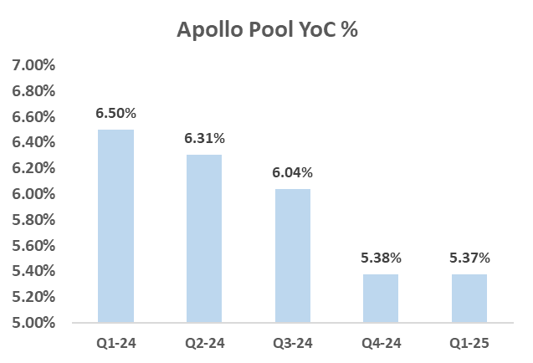
Same Store Analysis – Apollo Refi Pool
Finance team internal analysis
Key Takeaways
Overall, the performance is aligned with business plan.
Additional Rent - The increase is mainly due to change of assumptions for RET and Insurance.
162M
Total Cost
13
Buildings

Slide 100
Actual vs. Budget – Apollo Refi Pool
Finance team internal analysis
Key Takeaways
Overall, the actuals and the budget are aligned.
Additional Rent - The increase is mainly due to change of assumptions for RET and Insurance.
The budget column represent the annual properties budgets from 03/2025.
162M
Total Cost
13
Buildings

Slide 101
Yield on Cost & CapEx Forecast | Apollo
CorpFin to update
Key Takeaways
Yield on Cost for the Apollo properties decreases significantly in 2026 primarily due to Marcolin lease expiration in Jan 2026
CapEx fluctuates over time, with it peaking in 2026
Accumulated CapEx and TI/LC reach ~$15.7M for the Apollo Pool by the end of 2028

Slide 102
Debt Yield Covenant Analysis| Apollo
Key Takeaways
The Debt Yield Covenant increases from 8.75% to 9.00% in Q4 2025 and to 9.25% Q4 2027
Due to downtime and concessions in 2026, we see a reduction in the DY to 9.66% in Q3 2026 (still above 9.0% covenant)
An additional 5% vacancy/credit loss factor is applied to T12 NOI in all quarters to be conservative, regardless of actual vacancy
Debt Yield Covenant uses T12 NOI for calculation

Slide 103
Blackstone Pool

Slide 104
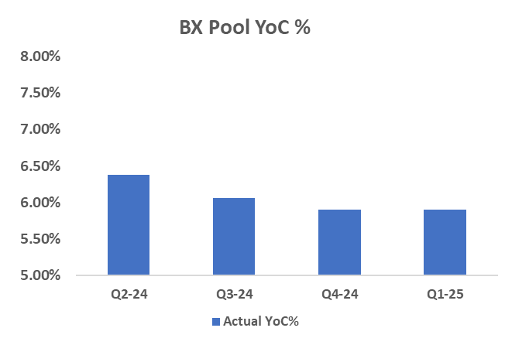
Same Store Analysis – Backstone Refi Pool
Finance team internal analysis
Key Takeaways
Overall, the performance is aligned with business plan.
Additional Rent - The increase is mainly due to change of assumptions for RET and Insurance.
129M
Total Cost
16
Buildings

Slide 105
Actual vs. Budget – Blackstone Refi Pool
Finance team internal analysis
Key Takeaways
Overall, the actuals and the budget are aligned.
Property Taxes and Insurance higher than budget due to updated assumptions for RET tax and insurance.
Utilities Expenses higher than budget due to the timing of the charges.
The budget column represent the annual properties budgets from 03/2025.
129M
Total Cost
16
Buildings

Slide 106
Yield on Cost & CapEx Forecast | Blackstone
CorpFin to update
Key Takeaways
Yield on Cost for the Blackstone properties float between the 6.1% - 6.5% range through the remaining life of the fund
CapEx peaks in 2024, with $2.7M forecasted in Q4 2024
Accumulated CapEx and TI/LC reach ~$14.5M for the Blackstone Pool by the end of 2028

Slide 107
Credit Facility Pool

Slide 108
Yield on Cost & CapEx Forecast | Credit Facility
CorpFin to update
Key Takeaways
Yield on Cost for our seed portfolio grows most sharply in 2026 and 2027 as a large amount amount of leases roll in 2025-26
CapEx peaks in 2025 at ~$8.0M and then fluctuates over time
Accumulated CapEx and TI/LC reach ~$60.6M for the Credit Facility Pool by the end of 2028

Slide 109
Definitions

Slide 110
Definitions
Net operating income (NOI): We define NOI as rental income, including reimbursements, less property expenses, which excludes depreciation, amortization, loss on impairments, general and administrative expenses, interest expense, interest income, transaction costs, gain (loss) on involuntary conversion, loss on extinguishment of debt, gain on sales of rental property, Non Recoverable expense and other expenses.
Project Cost: The amount of cash or cash equivalents paid or the fair value of the other consideration given to acquire an asset at the time of its acquisition or construction, or, when applicable, the amount attributed to that asset. (Including Capex (General Building Improvement, Tenant Improvement and Leasing commission)
Yield On Cost: Yield on cost measures income in relation to the total cost of the property YOC% is calculated as a property's Net Operating Income (NOI) divided by the total project cost.
Same Store NOI: We evaluate the performance of the operating properties we own and manage using a “same store” analysis because the population of properties in this analysis is consistent from period to period. We define our same store population for the three months ended Sep 30, 2023 as the properties in our Owned and Managed Operating Portfolio, properties owned by the Fund as at March 31, 2023.

Slide 111
Definitions (continued)
Funds from Operation (FFO): We define FFO in accordance with the standards established by the National Association of Real Estate Investment Trusts (“NAREIT”). FFO represents net income (loss) (computed in accordance with GAAP), excluding gains (or losses) from sales of depreciable operating property, gains (losses) from sales of land, impairment write-downs of depreciable real estate, real estate related depreciation and amortization (excluding amortization of deferred financing costs and fair market value of debt adjustment) and after adjustments for unconsolidated partnerships and joint ventures.
Core FFO: Core FFO excludes transaction costs and non-recurring other expenses.
AFFO: To arrive at AFFO, we adjust Core FFO to include realized gains from the disposition of land and development properties, net of current tax expense, and recurring capital expenditures and exclude the following items that we recognize directly in Core FFO: straight-line rents; (ii) amortization of above- and below-market lease intangibles; (iii) amortization of management contracts; (iv) amortization of debt premiums and discounts and financing costs, net of amounts capitalized, and; (v) stock compensation amortization expense.
Base Interest Rate- The actual Interest that was paid during the period.
Effective Interest Rate (W/O Origination fee amortization)- Base interest Rate plus amortization of hedging costs
Effective Interest Rate- Base interest rate plus hedging costs & origination fee amortization.
Recovery Ratio - Recoveries Incomes/Recoverable and Non-Recoverable Expenses. The KPI will be used to measure our ability to collect recoveries from tenants.

Slide 112
Recurring Commitment Fees Calculation
Fund Finance Team – Not Required?
Methodology:
The commitment fee operates as a commercial mechanism where investors pay a fee based on a percentage of their commitment to the fund, starting from day 1, even though their contributions may be called in parts over the deployment period.
The underlying assumption is that part of the commitment fee compensates the General Partner for their efforts, especially in areas such as acquisitions and financing.
Therefore, it is fair to say that a portion of the fee should be considered a "one-time" expense during the deployment period.
The formula isolates the "recurring" part of the commitment fee by calculating the theoretical "invested commitment" for the period.
This is done by determining the equity that would be required to purchase the current properties using the target Loan-to-Value ratio of the fund. This theoretical equity represents the "investment commitment" used in calculating the recurring commitment fee.
Any remaining expenses recorded in the fund's books would be considered as q one-time expense for this quarter.
WATC – Weighted Average of Total Cost.
Average % Commitment fees - The percentage represents the current actual fee percentage of all the investors.
Theoretical Equity – The expected % Equity at the end of the deployment multiplied by the WATC.
Back to G&A Breakdown

Slide 113
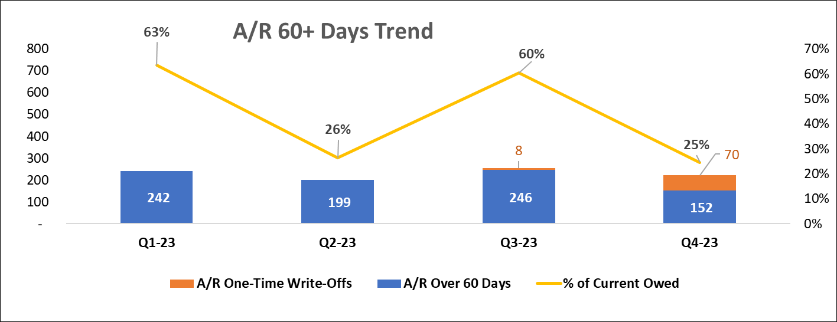
A/R Tenants – Allowance for Doubtful accounts & Write Offs
Fund Finance Team – Not Required?
An allowance for doubtful accounts is a contra-asset account that reduces the value of accounts receivable.
It estimates the accounts receivable that are expected to be uncollectible.
The allowance is determined as follows:
A/R Write-Offs:
During Q4-23 there was a write off in the amount of $70k for the tenant Milano Foods in the property 1253 Glen Avenue Moorestown, NJ.
Business Reason: We believe the Tenant is unwilling or unable to pay the outstanding amount. Despite the write off we will soon have a $100k default monetary judgement against the Tenant as an individual and corporation from the local
court. Once secured we can assign to a commercial tenant debt law firm or collection agency if we want to consider utilizing in our market to attempt to collect.
Back to the Balance Sheet

Slide 114
A/R Aging
Fund Finance Team – Not Required?
Key Takeaways
Consider Write off of the $90k balance of HIS Restoration, LLC
5 high AR balance tenants

Slide 115
G&A Breakdown & Run Rate
Fund Finance Team – Not Required?
Back to the P&L
Key Takeaways
Find out more about Recurring Commitment Fees.
Feeders Expenses – Not part of the Fund G&A as it recorded on the Feeders books. mainly consists of the 2022 tax return fees and REIT compliance consulting expenses to KPMG US.
Legal Fees – Fund level – side letters, PPM supplements, LPA amendments, advising DDQ processes, regulatory compliance, expense allocation advise.
Software – mainly paid by the GP and allocated to the Fund, includes Compstack, Atlas, Costar, Cherre, rDCF, Preqin, IT, IR software, etc.

Slide 116
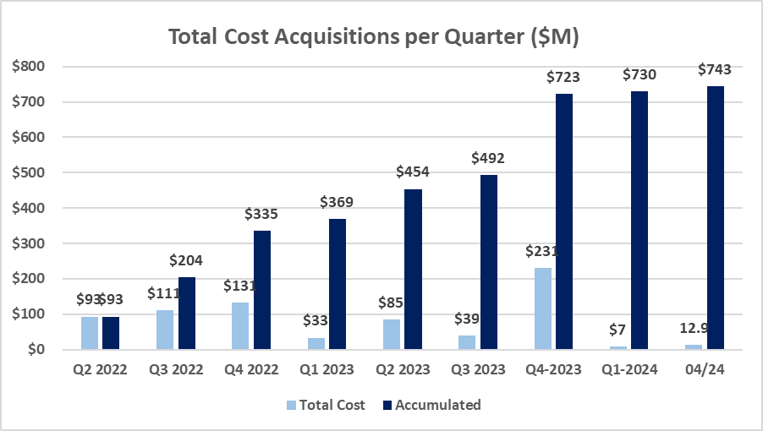
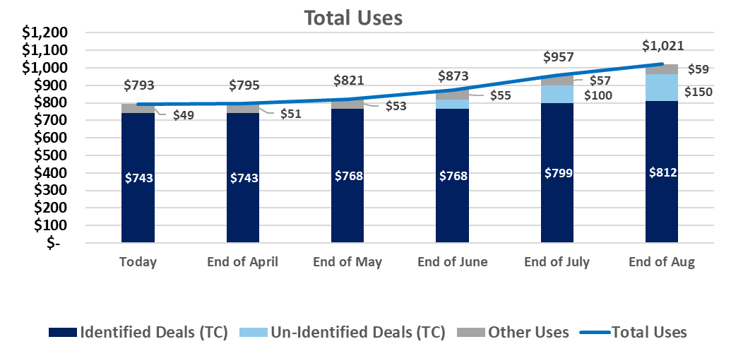
Uses – as of April 22, 2024
Fund Finance Team – Not Required?
Key Takeaways
The Identified Deals are based on FaroS.
Un-Identified Deals – using default assumption of 50M for the last 2 months for the projection.
Other Uses - including but not limited to hedging costs, origination fees, Capex, organizational expenses, etc. The calculation uses the actual expenses + general assumption of $2M per month.
Back to the Balance Sheet

Slide 117
Fixed Charge Coverage Ratio
Fund Finance Team – Not Required?
Key Takeaways
The FCCR improved from 1.78 last quarter to 1.84 this quarter mainly due to the properties performance improvement (5.7% YoC in LTM ended 3.24 compared to 5.5% in LTM 12.23)
The Non-Recurring and Non-Cash expenses are taken from the G&A Breakdown slide (one-time expenses, excluding the Feeders expenses).

Slide 118
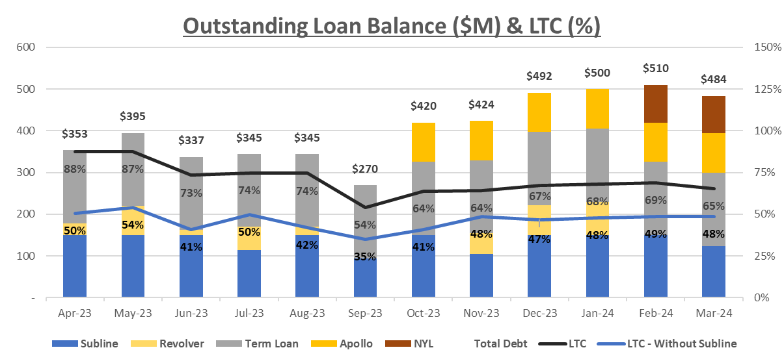
Financing Metrics
Fund Finance Team – Not Required?
Key Takeaways
The weighted average Loan-to-Cost (LTC) in Q1-24 is 68% including the Subline (65% in Q4-23), and 49% excluding the Subline (44% in Q4-23).
The weighted average LTC, excluding the Subline but including credit facility availability is 56% in Q1-24.
Back to the Balance Sheet

Slide 119

Financing Metrics (continued)
Fund Finance Team – Not Required?
According to the original Hedging policy, there should be 75% hedged out of the theoretical debt (83% as of the Quarter-End).
In Addition, the allocation between Cap and SWAP should be 50% each (as of Quarter-End, it’s 61% Cap and 39% SWAP).

Slide 120
Cash Flow
Fund Finance Team – Working on it
Key Takeaways
The Net Cash for Operating Activities (minus $1.2M in Q4-23) should be close to the Core FFO. The main difference between the Core FFO ($0.7M in Q4-23) is related to One-time expenses that are excluded from the Core-FFO.
Additional differences are due to timing differences (the change in working capital), Deferred State Tax, the Change in the Allowance for Doubtful Accounts, and the Financing cost amortization.

Slide 121
Margins Analysis
Not sure will be presented- subject to finalization and verification
Key Takeaways
Fund 3 margins are higher the fund 2 (add)
FM represent margins off?
RDCF Represen
Place Holder for Occupancy data (physical and economical)

Slide 122
A/R General Allowance - Deep Dive
Fund Finance – updated
Key Takeaways
Key Considerations
General Allowance – Balance of A/R determined based on the A/R Age and % of Allowance, that we estimate will not be collected in the future
A/R General Allowance is recorded at the Fund-level, NOT at the individual Property-level
Financial Metrics Impact
Property Level – No impact in the tenant ledger or A/R Balance of the fund
Fund Level
YOC – No impact
NOI (for bank covenants) – No Impact
FFO – Impact
Core FFO (Distribution Decision) – Impact
Audited P&L - Impact

Slide 123


Financing Cost Summary – Life Company Refi’s
Properties (Number/TC) | 10 / $ 145.3M | 13 / $ 161.5 M | 16/ $ 128M
Term | 5 Years (Mar ‘29) | 5 Years (Oct ’28) | 5 Years (Oct 29’)
Outstanding Loan | $ 90M | $ 94.5M | $81.5M
*Net Proceeds | $ 88.6M | $ 88.4M | $ 78.7 M
Interest Rate | 6.30% | 6.15% | 6.53%
Closing Costs | $ 1.44M | $ 2M | $ 2.1M
Upfront Reserves | - | $4M | $0.7M
Ongoing Reserves Payments Capex/Tax |  | 166K/122K | 26K/114K
LTC | 62% | 59% | 63%
**Effective LTC | 61% | 55% | 61%
***Effective Interest base rate | 6.40% | 6.58% | 6.77%
Closing Cost out of outstanding Loan | 1.6% | 2.13% | 2.61%
Key Takeaways
Higher Closing Costs: Loan closing costs are significantly higher than current model estimates, ranging between 1.6% and 2.61%.
Impact on Effective LTC: The higher closing costs and loan reserves have a significant impact on the effective LTC ratio.
Decreasing LTC Over Time: For these loans, the LTC will decrease over time as no additional draws will be made to finance CapEx
Ongoing Reserves Impact: The ongoing reserves for taxes and CapEx reduce the overall efficiency of the loan. A methodology to capture this impact still needs to be developed.
NYL Loan Efficiency: When factoring in expenses and reserve requirements, the NYL loan emerges as the most efficient option. This may also be related to the quality of the portfolio.
* Net Proceeds- Outstanding Loan minus Closing Costs and Upfront Reserves
**Effective LTC- Net Proceeds divided by TC
***Effective Interest Rate- expected interest expenses divided by Net Proceeds

Slide 124
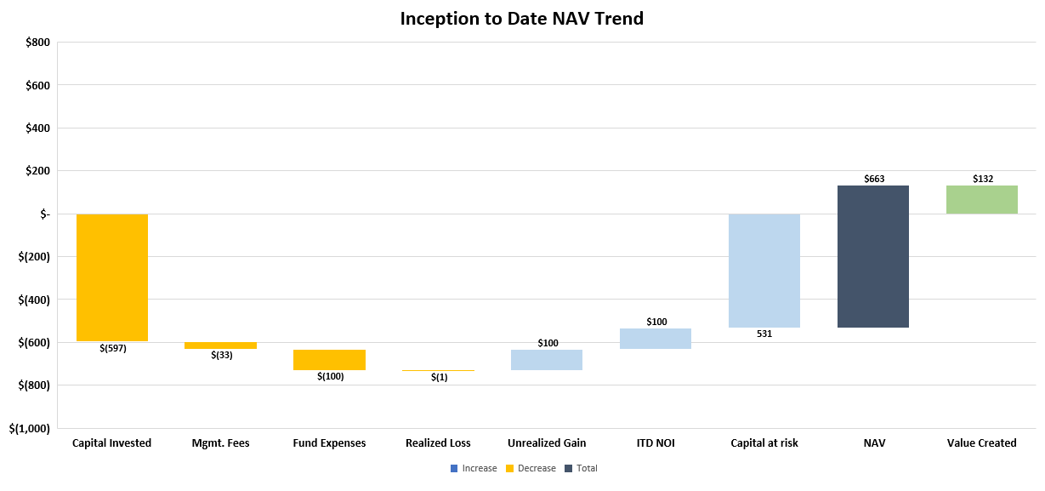
Under Review

Slide 125
Ready for review–
Fund Finance
Development Deals| Underwriting Comparison
1
2
Key Takeaways
No significant changes in Hazel Park UW, Swedesboro is still in entitlement stage therefore too early to determine if any significant UW changes will materialize.
Joyce Kilmer -
Total contributions have decreased due to an increase in the expected construction debt loan. We will receive proceeds once the loan is finalized.
Lincoln Swisher –
Total underwritten contributions have decreased because of the increased expected construction debt loan. Most contributions are upcoming, and actual contributions align with the revised underwriting.
1
2

